Slide 1
University-Wide Budget Planning Committee
New Jersey Institute of Technology
Overview of Structure, Process, and Outcomes
January 7, 2022
Notes:
Start by thanking the team -- challenges, yes -- but encouraged by the team I am working with both within Finance and outside of the department.

Slide 2
Subcommittee Teams and Focus Areas
1A - New Students Recruitment & Marketing
Lead Facilitator – Louis Hamilton – Dean, ADHC
Alan Yan - Associate Dean & Professor of Finance
Cristina Craig - Associate Director of Marketing
Dimana Kornegay - Director, Admissions & Recruitment Mktg
Ed Wozencroft - Associate CIO Enterprise Applications
Tracy MacDonald - Director of Administration
Clarisa Gonzalez - Graduate Research & Student Recruitment
1B - Continuing Students & Growth (Online & Global)
Lead Facilitator – Michael Koskinen – Director, User Services and Technology
Dan White - Associate Provost, Online Programs
Bruce Bukiet - Professor
Kelly Mongelli - Associate Director, Academic Advising
Ivon Nunez - Executive Director, Student Financial Aid Services
Lynn Pawlowski - Student Persistence & Re-Enrollment Manager
Richard Cimino - Senior Lecturer
2 - External Sources – Research & Fundraising
Lead Facilitator – Donna Russo – Executive Director of Development for Special Partnerships & Initiatives
Craig Gotsman - Dean, YWCC
Oya Tukel - Dean, MTSM
John McCarthy - Director of Research
Kevin Belfield - Dean, College of Science & Liberal Arts
Mariel Diaz - Director, Post-Award Management
Rick Rosenberg - Director Corporate & Foundation Relations
Taha Marhaba - Professor & Chair
Zhi Wei - Professor
Control Expense Growth

Slide 3
Subcommittee Teams and Focus Areas
3 – Auxiliaries & Other Sources
Lead Facilitator – Chelsea Samuelson – NJII Commercialization
Dan Brateris - Director of Experiential Learning
Karen Quackenbush - Director or Residence Life
Latosha Wilson - Associate Director, Campus Reservations & Operations
Lorie Brown - Executive Director, Strategic Events & Conference Services
Rob Gjini - Assistant Vice President, Facility Systems
Andrew Schwartz - Sr. Associate Director, Athletics
Sean Dowd - Associate Dean of Students
Phil Stickna - Associate Director, Media Technology Support Services
4 - Operating Efficiencies
Lead Facilitator – Melodi Guibault – Assistant Dean, MTSM
Blake Haggerty - Associate CIO, Digital Learning Campus Support
Burcak Ozludil Altin - Associate Dean
Joseph Wilson - Associate VP, HR
John Wolf - Assistant Dean
Ron Martucci - Associate Vice President, Facilities Services
Sam Strum - Director of Business Intelligence
Sharyn Serafin - Manager, REDCO Administration
Eugene Deess - Executive Director, Institutional Effectiveness
Control Expense Growth

Slide 4
Suggested Focus Areas
Team 1A -New Students - Recruitment, Marketing, Yield. Items to consider:
Yield Rate – Applications, Accepts, Deposits, Enrolled
Student Discount Rate & Institutional Aid
Branding & Marketing Strategy
Competitors and Pricing
Team 1B – Continuing Students, New Programs (Online & Global). Items to consider:
Retention Rate and how to retain
NJIT Global – Online Strategy
International Satellite Campus (Egypt) Opportunities
Control Expense Growth
Team 2 – External Sources – Research & Fundraising. Items to consider:
Research grant proposal yield – External factors – what fields have the most Funding Allocated
Partnerships / Collaborations
Sponsorship Strategies e.g. Target operations that could be fully or partially funded externally
Team 3 – Auxiliaries & Other Sources. Items to consider:
Conferences & Facility Rental – opportunities & challenges (eSports)
Makerspace – Outside Usage
Residence Halls
Parking Services
Intellectual Property & Commercialization
Team 4 – Operating efficiencies & cost avoidance. Items to consider:
Administrative staffing levels & operations
Process improvements – Value added vs Non Value Added
Digitizing workflows and approvals
Facilities & Space utilization

Slide 5
Committee Proposal Development Timeline
1/7 – Kick-Off Meeting – Brainstorming & Data Requests
Week of 1/10 – Subcommittees meet and review proposals and data in the context of an impact assessment – outcomes, resources, and time commitment
Week of 1/17 – Full Committee meeting to review ranked committee proposals
2/2 – 1st Draft recommendations due for each subcommittee
2/7 - Draft Executive Summary of recommended actions, costs, and implementation timeline shared with Committee for technical review; period open 2/7 - 2/13

Slide 6
Subcommittee Team Roles
Control Expense Growth
Facilitator
Timekeeper
Recorder
Participant
Develops & keeps agenda
Maintains a positive safe atmosphere
Assigns action items
Communicates
Manages time
Manages visual aids
Participates
Records key decisions, conclusions, and action items
Compiles notes and conclusions
Participates
Understands
Contributes
Presents ideas

Slide 7
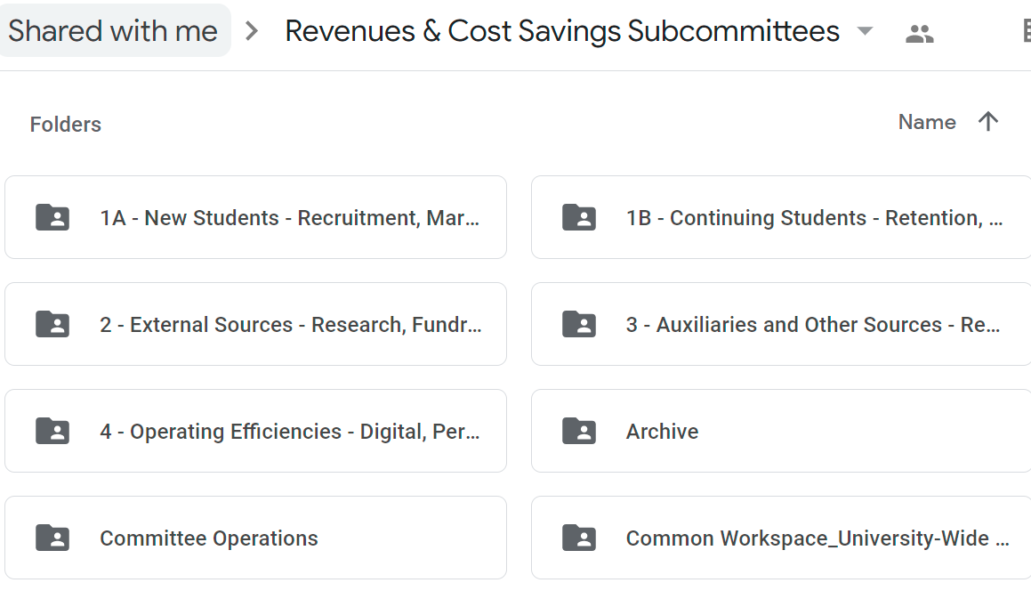
Google Share Drives - Team Workspaces
All work should be kept in the google share drive. Each subcommittee has their own working folder
Common workspace is where all information that will be shared with the entire committee should be kept
Google Jam (Whiteboards) should be moved to your subcommittee folders

Slide 8
Process for Proposal Development
Information Gathering
Full Proposal Development
Initial assessment to see what would be the greatest impact (financial) proposal – Information Requests
Template for full proposal development
1
2
3
4
5
Brainstorming
Proposal Feasibility & Impact
Submission of Proposals
Get as many ideas as possible to pursue further
Further drill down on proposal to start to consider impact, resources & ROI, and timeline
Final proposals from each subcommittee will be consolidated and shared with Senior Administration

Slide 9
Resources and Templates
Resources
Budget Office Team Members Assigned to each Focus Area
Financial Data
Office of Institutional Effectiveness
Student Data
Faculty & Course Data
*Schedule – Committee with Resources Assigned in Google Drive
Templates & Tools
Brainstorming spreadsheet
Google Whiteboard (Jam)
Impact Assessment Rubric
Developing Proposals for Consideration & Action Plans

