Slide 1
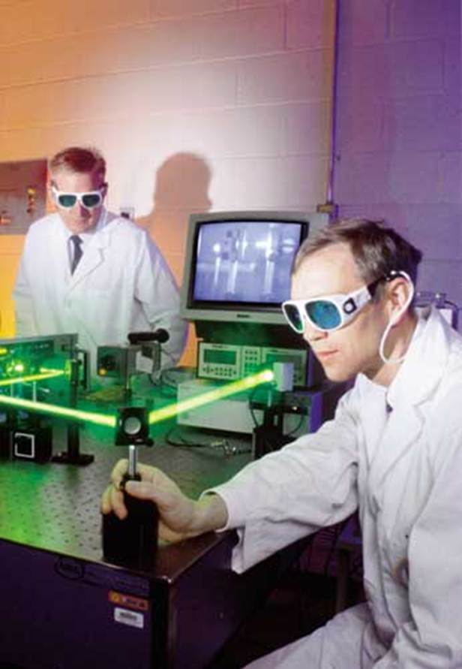
Laser Safety Training
Therese Perrette CIH, CSP
Therese Perrette CIH, CSP
Marsh Risk Consulting
1
Notes:
This training was developed for those individuals who work with, or near, Class 3B or Class 4 lasers, or who service and/or maintain laser systems.

Slide 2

Laser Safety Training Objectives
Determine laser classes and components
Identify hazards
Biological
Non-Beam
Implement controls
Engineering
Administrative
Work Practice
PPE
2
Notes:
By the end of this training you should be able to…
Differentiate between laser classes and the different parts of a laser
Identify hazards (including both the biological effects of lasers, as well as the non-beam dangers presented), and
Implement controls (including engineering and administrative controls, good work practices, and the use of PPE

Slide 3
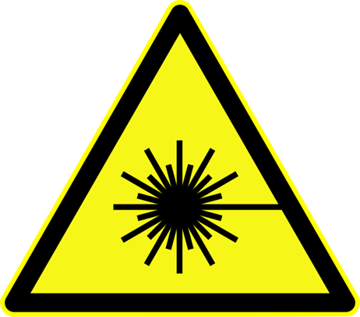
What is a Laser?
Lasers
Intense light that can cause tissue damage, burns, and damage to the eye and skin.
Light
Amplification by
Stimulated
Emission of
Radiation
3

Slide 4
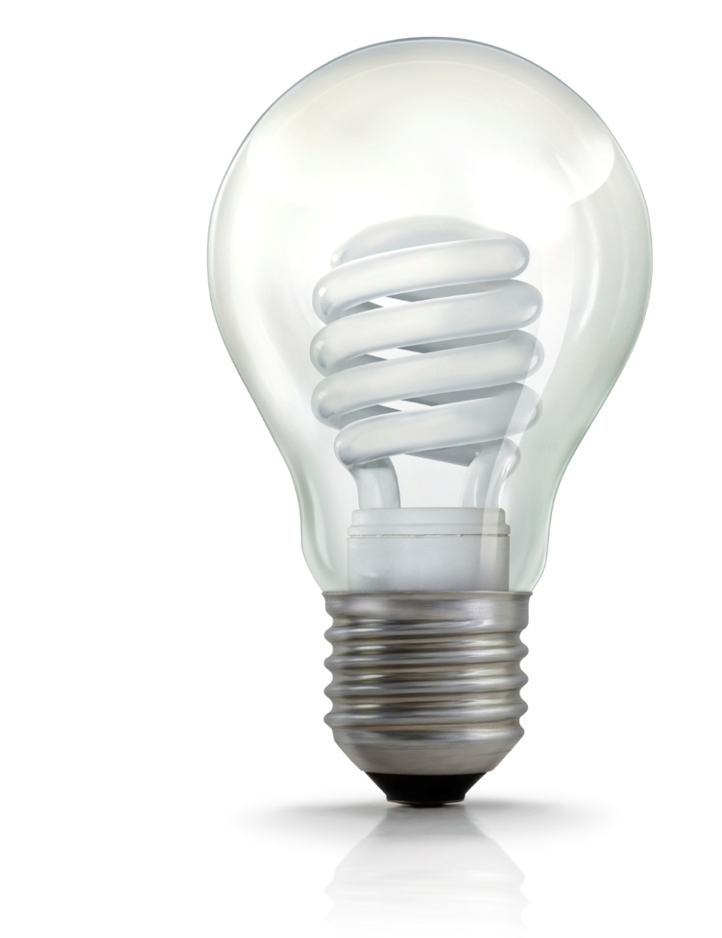
Ordinary light is incoherent, visible, dispersed, and low powered.
4
Notes:
Laser light is different from ordinary light, like the type you find in a light bulb. Ordinary light is incoherent. This means that it has many wavelengths, that move in many directions, and thus can emit many different colors. This results in light that has a low concentration of power per surface area.

Slide 5
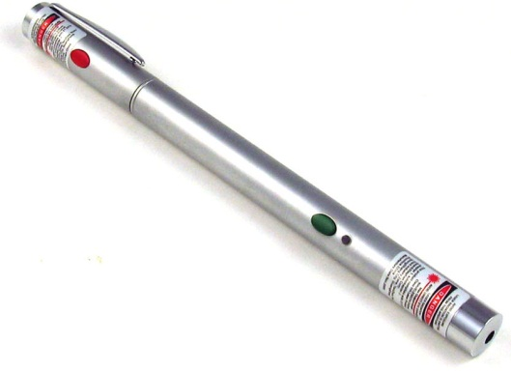
Laser light is coherent, sometimes invisible, directional, and high powered.
5
Notes:
In contrast, laser light is coherent. This means that the light rays have the same wavelength (that move in unison), travel in one direction, and have one specific color of light (or what is known as “monochromatic”). This results in a narrow laser beam that has a high concentration of power per surface area.

Slide 6
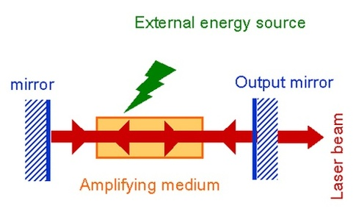
Laser Elements / How it Works
Pump provides energy
The mirrors make up the optical resonator
The lasing medium determines the wavelength
A laser is created when the electrons in atoms in special glasses, crystals or gases absorb energy and become excited. When the excited electrons return to their normal state they emit photons (particles of light). Mirrors and lenses get all the light traveling in the same direction.

Slide 7
Output
CW = The beam is emitted at a constant power for at least ¼ second
> ¼ sec
Continuous
Pulsed = The optical power appears in pulses of some duration at some repetition rate.
< ¼ sec
Pulsed
7
Notes:
Lasers also differ from each other based on its output characteristics. It can be a continuous wave, or a pulsed, laser beam.
Continuous wave lasers emit beams at a constant power (similar to a flashlight) for at least ¼ of a second. This is enough time for serious eye damage, if the laser has a high enough power. Power for these lasers is expressed in the form of Watts.
Pulsed lasers emit beams in a single pulse, or train of pulses for a period less than ¼ of a second. If you’re struck in the eye by one pulse, you are unlikely to be struck by a second pulse due to this time gap. However, pulsed lasers are usually more hazardous than continuous lasers because the peak power for each pulse can be very high, causing biological damage to the eyes and skin. Energy for these lasers is expressed in the form of Joules per second.

Slide 8
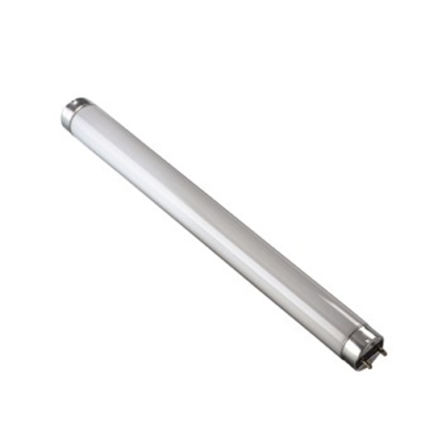
What do you think?
Which component can be adjusted to control the output power (or energy) of the laser?
Pump
Mirror
Transparent
Lasing Medium
8
Notes:
Knowing how a laser works enables you to better control the laser beam.

Slide 9
Adjust the pump to control the output power.
Which component can be adjusted to control the beam stability?
Pump
Mirror
Transparent
Lasing Medium
9
Notes:
You can control the output power of the laser by adjusting the pump.

Slide 10
Adjust the optical resonator to control the beam stability.
Pump
Mirror
Transparent
Lasing Medium
10
Notes:
You can adjust the stability of a beam by working with the partially transmitting mirror (also known as an optical resonator).

Slide 11
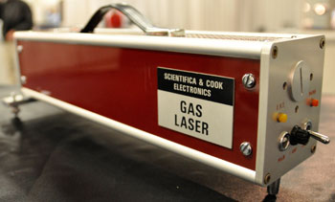
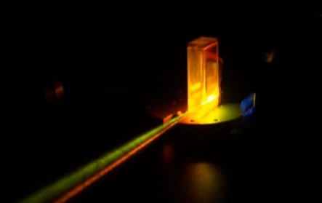
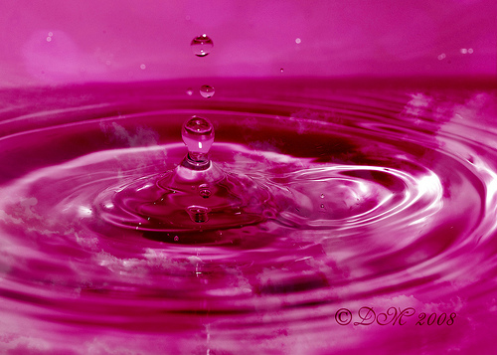
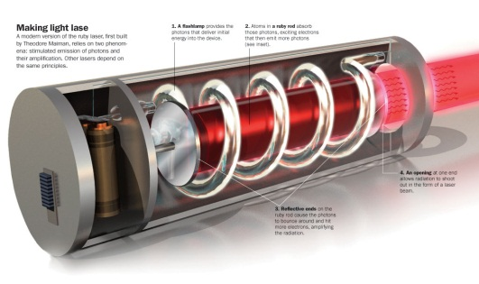
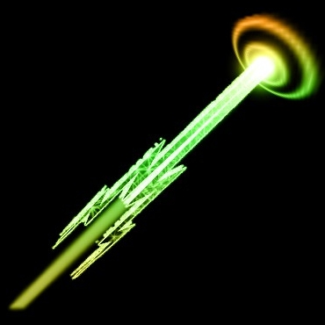
Physical State
Gas
HeNe Excimer
Argon
Liquid
Dye
Lasing Medium
Solid
Ruby
Nd:YAG
Ti:Sapphire
Semi
conductor
Diode
11
Notes:
Lasers differ from each other based on the kind of lasing medium they use. It can be a gas (such as Argon), solid-state (such as Ruby crystal), liquid (or a dye), or semi-conducting material (such as a diode).

Slide 12

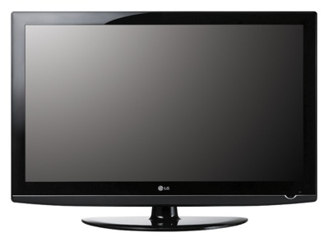
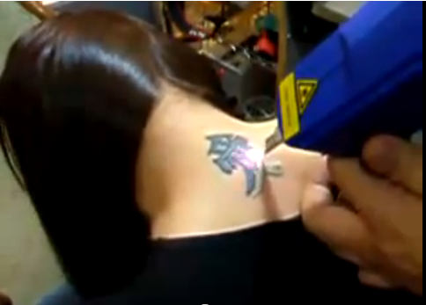
What do you think?
What type of lasing medium does a Nd:YAG laser use?
Continuous
Gas
Incoherent
Pulsed
Solid
12
Notes:
The laser used to remove the tattoo in this scene is an example of a Q-switched Neodymium-YAG (Nd:YAG) laser. It is one of the most widely used laser sources for moderate to high power, using a neodymium doped crystal Yttrium (pronounced i-tree-uhm) Aluminum Garnet to generate a pulsed laser. What type of lasing medium is this?

Slide 13
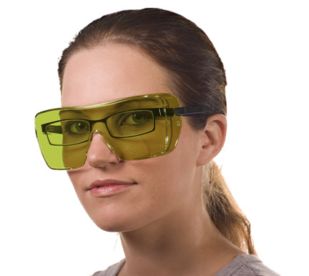
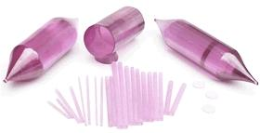
The Nd:YAG is a solid-state laser.
Use appropriate eye protection.
Solid
13
Notes:
The Neodymium-YAG (Nd:YAG) laser is an example of a solid-state laser system because it uses a crystal to generate a pulsed laser. Because these types of lasers are rugged, simple to maintain, and capable of generating high-powered pulses; make sure you use appropriate laser safety eye protection.

Slide 14
Classes of Lasers
Class 1 Exempt
Not capable of producing damaging radiation levels during normal operation.
E.g. Laser printer, CD-Rom
Class 2 Low Power CW to 1mW
Lasers emit visible light.
Not hazardous if viewed less than 0.25 second.
E.g. Barcode Scanner.
Class 3a Low Power CW 1 to 5 mW
Lasers probably not hazardous if viewed within 0.25 seconds.
Hazardous if viewed with collecting optics.
Some require DANGER labels.
E.g. Laser Pointer.
Notes:
Class 1 Low-power visible light lasers or laser systems that:
Do NOT normally present a hazard because of the normal human aversion response
Potential for hazard if viewed directly for extended period of time
similar to many conventional light sources
Class 2 and 3 Wont normally injure the eye if viewed for momentary period (within the aversion response period) with unaided eye
May present a greater hazard if viewed using collection optics.
Must carry a caution label.

Slide 15
Classes of Lasers
Class 3b Medium Power CW 5 to 500 mW
Hazardous if viewed directly or by specular reflection.
Diffuse reflection not usually hazardous.
Hazardous to eyes for intrabeam viewing
Requires DANGER sign
If the entire beam is not enclosed or if a limited open beam exists, the laser operator, supervisor or laser safety officer should determine a Nominal Hazard Zone (NHZ).
An alarm, warning light or verbal countdown should be used during use or start up of the laser.
Notes:
A laser hazard analysis, including determination of the MPE and Nominal Hazard Zone (NHZ), must be made.

Slide 16
Classes of Lasers
Class 4 High Power Exceed 0.5W
Hazardous under all viewing conditions: direct, specular and diffuse.
Potential fire hazard when in contact with combustible materials
Produce skin hazards from ultraviolet radiation.
Can produce laser generated air contaminants and hazardous plasma radiation.

Slide 17
Classes of Lasers
Class 3b and 4 lasers:
The controlled area should
· have limited access to spectators,
· have beam stops to terminate potentially dangerous laser beams,
· be designed to reduce diffuse and specular reflections,
· have eye protection for all personnel,
· not have a laser beam at eye level,
· have restrictions on windows and doorways to reduce exposure to levels
below the MPE, and
· require storage or disabling of the laser when it is not being used.
If the MPE is exceeded, design viewing portals and/or display screens to reduce exposure to acceptable levels. Alignment procedures and collecting optics should be designed to ensure the MPE is not exceeded.
Only authorized, trained individuals should service the laser. Approved, written standard operating, maintenance and service procedures should be developed and followed.
Notes:
A laser hazard analysis, including determination of the MPE and Nominal Hazard Zone (NHZ), must be made.

Slide 18
Laser Hazard Calculations
Calculating MPE and NHZ
Determine the radiant power in watts, the beam diameter in centimeters and emergent beam divergence in radians of your laser. These values can be found in your manufacturer's manual.
Calculate the maximum permissible exposure (MPE) of your laser using the equation MPE = 4r/[π(a^2)]. In this equation, r is the radiant power in watts and a is the beam diameter in centimeters.
Calculate the nominal hazard zone (NHZ) using the equation NHZ = (1/d) x [(4r/MPEπ)^(1/2) - a]. In this equation, d is the emergent beam divergence in radians, r is the radiant power and a is the beam diameter.
Notes:
If your beam is not fully contained the
Identify the max safe energy by calculating the Max Permissible Exposure
Then define the Nominal Hazard Zone (NHZ), which is the area where the MPE may be exceeded.

Slide 19
Lasers Accidents
The most common cause of accidents with research lasers:
Not wearing appropriate goggles
Not reducing power for alignment procedures
Stray beams left uncontained by beam stops or other barriers
Notes:
A laser hazard analysis, including determination of the MPE and Nominal Hazard Zone (NHZ), must be made.

Slide 20
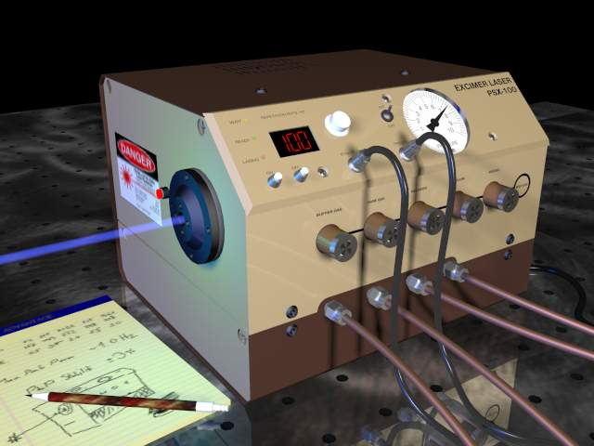
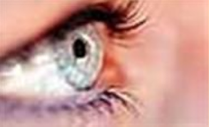
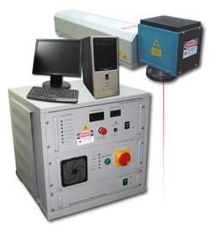
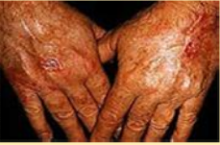


Biological Effects
XeCl gas excimer
Injuries
Prevent exposure to eyes and skin
Eyes
Skin
Nd:YAG
invisible
20
Notes:
When used improperly, lasers can cause injuries. The organs affected by exposure to are the eyes and skin. Some lasers can cause delayed effects after low-level exposures over long time periods (perhaps even for years). Most effects, however, are immediate following acute, brief exposures, lasting seconds or even much less.
Examples of two very dangerous lasers include the XeCl gas excimer which causes cataracts in the eyes, and the Nd:YAG Invisible laser which causes most skin injuries.
Being familiar with the most common types of laser injuries can help you prevent from repeating the same incidents.

Slide 21

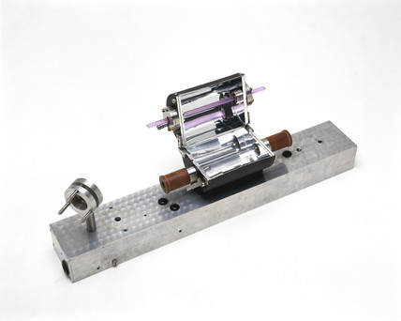
nm = 1 billionth of a meter
UV-C
UV-B
UV-A
IR-A
IR-B
IR-C
200 nm
280
315
400
780
1400
3000 nm
Ultraviolet
Visible
Infrared
21
Notes:
Today's laser light covers three ranges of the electromagnetic spectrum based on their wavelengths:
Ultraviolet (UV) light has a wavelength between 200 – 400 nm,
Visible light has a wavelength between 400 – 780 nm, and
Infrared (IR) light has a wavelength between 780 nm – 1,000,000 nm.
NOTE: 1 micron = 1,000 nm

Slide 22
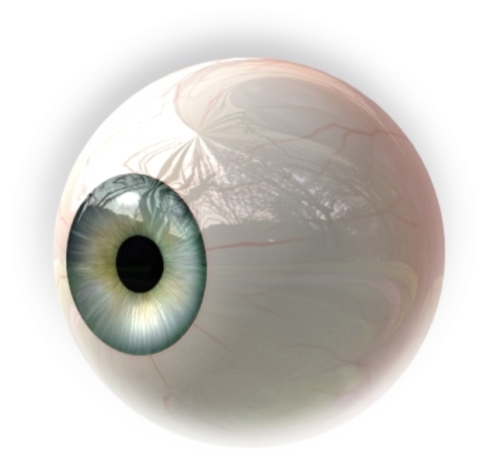
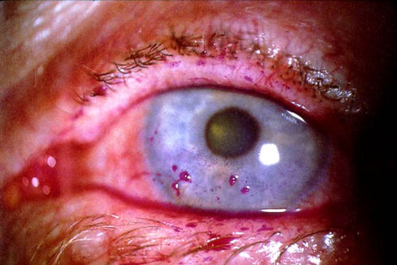
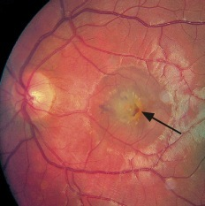
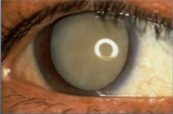
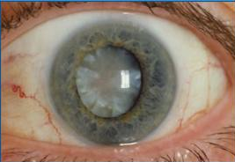
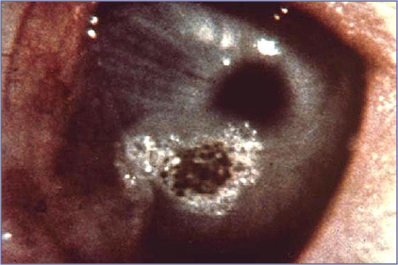
Biological Effects
Cornea
Lens
Photokeratisis
(200 – 315 nm)
Thermal retinal
injury
(315 – 400 nm)
Cataracts
(750 – 1400 nm)
Retina
Photochemical Cataracts
(315 – 400 nm)
Corneal burn
(1400 – 1,000,000 nm)
UV-C
UV-B
UV-A
IR-A
IR-B
IR-C
180
280
315
400
700
1400
3000
Ultraviolet
Visible
Infrared
22
Notes:
Your eyes are the organ most at-risk from laser use.
Different wavelengths cause varying levels of hazards to the eyes.
The pathological effects of UV lasers include photokeratisis (equivalent of sunburn to the cornea) and photochemical cataracts (clouding of the eye lens).
Visible light damage includes photochemical and thermal retinal injury (including blind spots and blurred vision).
Infrared lasers cause cataracts, retinal burns, corneal burns, aqueous flares, and/or IR cataracts.

Slide 23
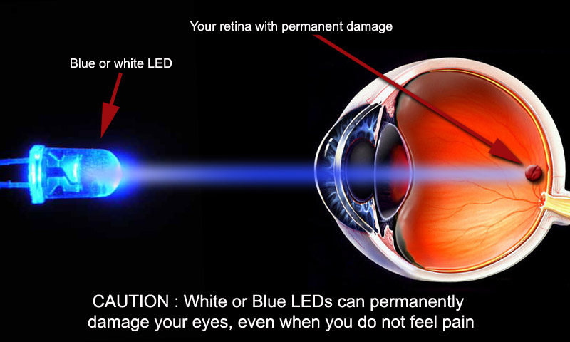
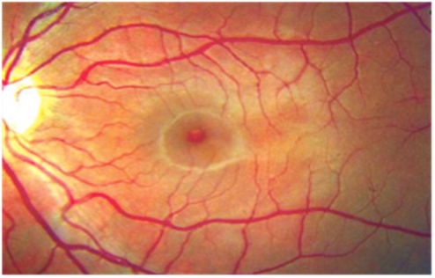
Biological Effects
Blue Light Hazards
Do not stare at sun,
welding arcs, or blue lamps
Prevent lengthy exposures
greater than 10 seconds
Beware of delayed
appearance (24-48 hours)
Blue Light Photobleaching
(400 – 500 nm)
Retina
UV-C
UV-B
UV-A
IR-A
IR-B
IR-C
180
280
315
400
700
1400
3000
Ultraviolet
Visible
Infrared
23
Notes:
Blue light (such as Argon lasers) and violet light can present what is referred to as the “Blue Light Hazard”.
An example of this is the retinal injury produced by staring at the sun during solar eclipses, staring at the arc produced during welding without eye protection, or staring at blue LED lamps.
Thus, make sure you protect yourself from this visible light by preventing lengthy exposure greater than 10 seconds.
This hazard can create a photochemical retinal injury that may go unnoticeable until 24-48 hours later.

Slide 24
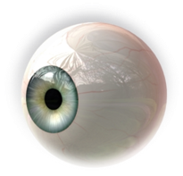

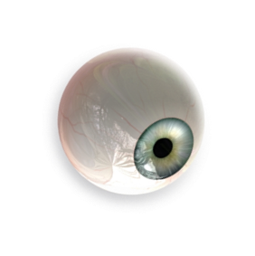
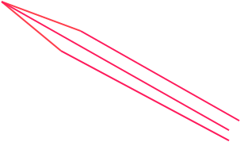

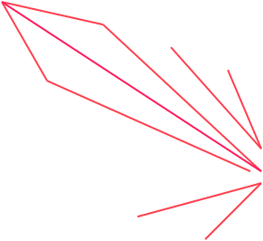

Biological Effects
Intrabeam
Viewing
Direct viewing
Flat Surface (mirror like)
ex: plastic, glass
Specular
Reflections
Rough Surface
(diffusion)
ex: table top
Diffuse Reflections
24
Notes:
How a laser light gets reflected contributes to its hazard.
You can get a laser eye injury in one of three ways: intrabeam viewing, specular reflections, and diffuse reflections.
Intrabeam viewing is where the eye is exposed to all or part of a laser beam.
Specular reflection is when the beam hits a flat surface such as a mirror and is reflected in one direction.
Diffuse reflection is when the beam hits a rough surface and is reflected in many directions.
Lasers that have shorter wavelengths (such as those in the UV region up to 315 nm) easily disperse off of rough surfaces through diffusion. In contrast, lasers that have longer wavelengths (such as those above 315 nm) tend to disperse easily off of flat surfaces through specular reflection.

Slide 25
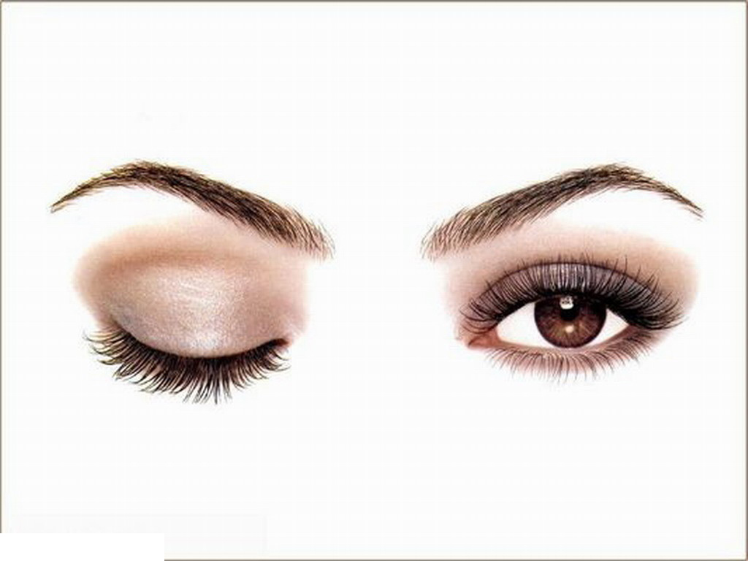
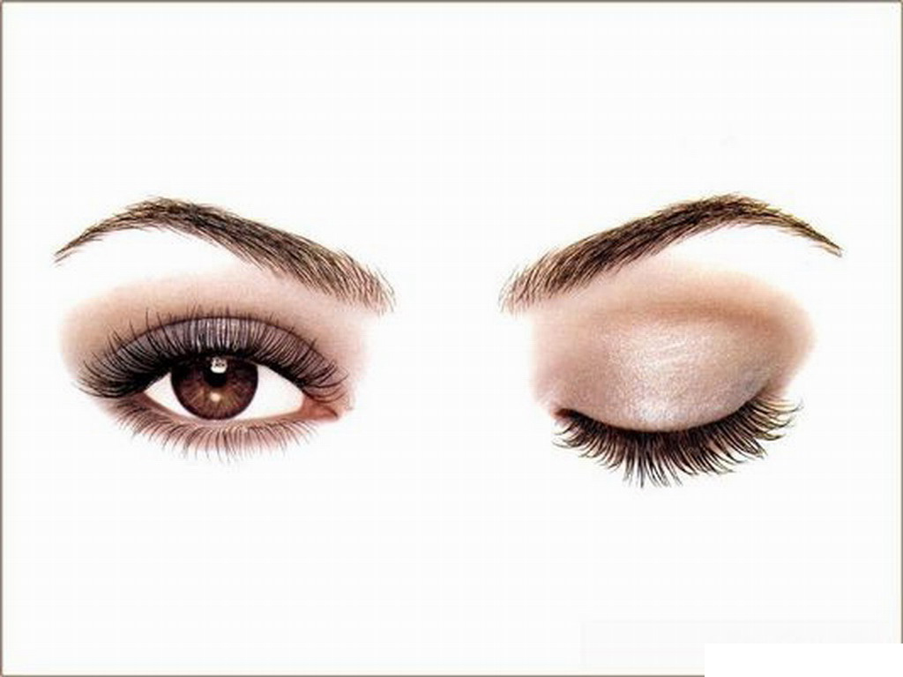
Aversion Response
Blink every ¼ seconds
Use laser eye protection.
Do not rely on your blink reflex for protection.
25
Notes:
Your body has a natural aversion response when it comes in contact with a laser beam.
Your head will tend to turn, and your eyes naturally blink.
This response occurs every ¼ of a second, and is used to calculate laser hazards.
However, because it may not always occur in all incidents, you should not rely on this response as a substitute for laser eye protection.

Slide 26
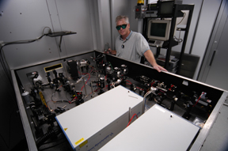
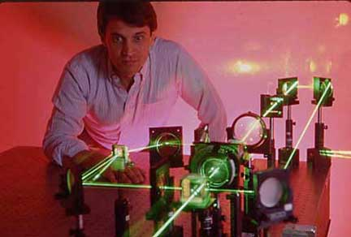

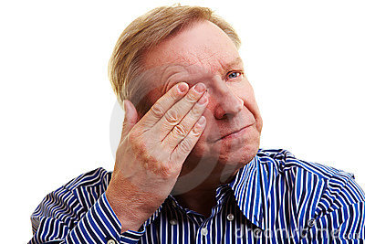

Signs and Symptoms
Before
After
Colors
Burning
Check for eye injury
See: Flash and after-image in opposite color OR difficulty detecting blue or green colors
Feel: Burning pain on cornea
Hear: “Pop” sound
Pop Sound
26
Notes:
Use your senses to check for eye injury. There are different effects on sight, feeling, and hearing.
Seeing
Exposure to a visible laser beam can be detected by a bright color flash of the emitted wavelength and an after-image of its complementary color. For example, a green laser would produce a green flash followed by a red after-image). When the retina is affected, there may be difficulty in detecting blue or green colors secondary to cone damage, and pigmentation of the retina may be detected.
Feeling
Exposure to an invisible carbon dioxide laser beam (10,600 nm) can be detected by a burning pain at the site of exposure on the cornea (or sclera).
Hearing
Photoacoustic retinal damage may be associated with an audible "pop" at the time of exposure. Visual disorientation due to retinal damage may not be apparent to the operator until considerable thermal damage has occurred. Exposure to a Q-switched Nd:YAG laser beam (1064 nm) is especially hazardous and may initially go undetected because the beam is invisible and the retina lacks pain sensory nerves.

Slide 27
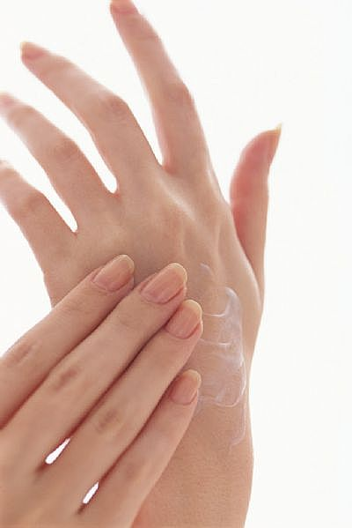
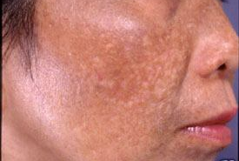
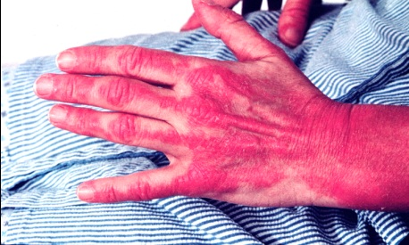
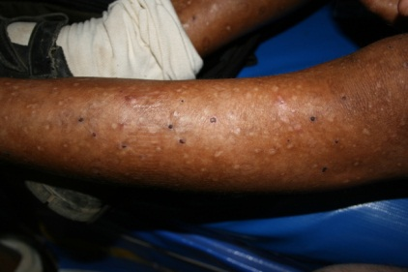
Biological Effects
Accelerated Aging
Increased Pigmentation
(280 – 315 nm)
Burns and Pigment Darkening
(315 – 400 nm)
Eurythema and Cancer
(200 – 315 nm)
Burns and Photosensitive reactions
(400 – 780 nm)
UV-C
UV-B
UV-A
IR-A
IR-B
IR-C
180
280
315
400
700
1400
3000
Ultraviolet
Visible
Infrared
27
Notes:
In addition, different wavelengths can also damage the skin. The pathological effects of UV lasers include accelerated aging or increased pigmentation, erythema (era-theme-a) and cancer, and burns and pigment darkening. Visible lasers can cause region burns and photosensitive reactions (or sun allergies).
Some compounds can increase skin sensitivity to ultraviolet radiation injury. This includes antibiotics, antihistamines, and cardiovascular drugs. Always read the labels on medication bottles to alert you to this risk.
Thermal damage dominates with pulsed lasers at any wavelength

Slide 28
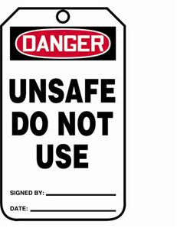
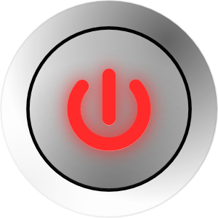
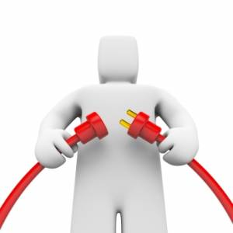
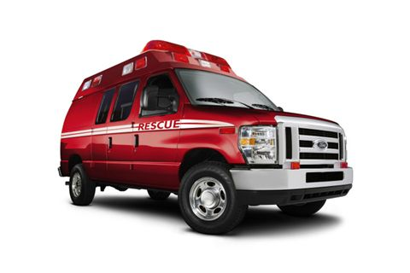
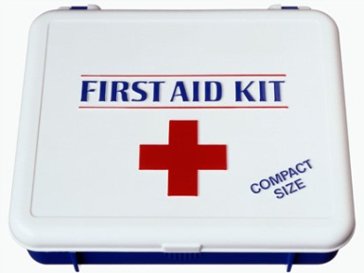
Biological Effects
Follow emergency procedures
Disable machine
Turn off, unplug, and post sign
Seek medical attention
Treat minor skin damage with first aid OR transport major skin or any eye injuries to medical facility
28
Notes:
In the event that a person suffers a laser injury, quick actions need to be taken. First, make sure that the laser involved is turned off, unplugged, and is not in use again until it can be determined that it is safe. Immediately seek medical treatment (do not permit anyone to delay getting attention). Minor skin damage can often be treated with first aid in the laboratory. Typically, however, people who suffer from serious skin injuries (involving bleeding, severe burn, or intense pain), or from any eye injuries need to be transported to a medical facility by other laboratory personnel. Do not allow injured people to transport themselves since they could be in shock or have impaired vision. Those with eye injuries should be kept calm and in an upright, seated position.

Slide 29






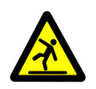
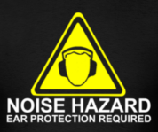
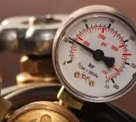
Non-Beam Hazards
What do you think?
What is the leading cause of death related to lasers?
Burns
Electrical
Cryogens
Chemicals
Fire
Housekeeping
Noise
Pressure
29
Notes:
All too often, laser users become so focused on protecting their eyes and skin, that they forget about the hazards around them. These include: exposure to electricity, cryogens, chemicals (toxic substances), fire, inadequate housekeeping, excessive noise, and pressure. Of these non-beam hazards, which do you think is the leading cause of death when working with lasers?

Slide 30
Non Beam Hazards
Prevent injuries and death related to electrical shock
Burns
Electrical
Cryogens
Chemicals
Fire
Housekeeping
Noise
Pressure
30
Notes:
Next to eye injury, the most common laser injury is electrical shock. So far, all deaths related to lasers have been from electrocution. These deaths occurred while people worked on high voltage power supplies.

Slide 31
Non-Beam Hazards
Burns
Electrical
Cryogens
Chemicals
Chemicals
Fire
Fire
Housekeeping
Noise
Pressure
31
Notes:
In addition to discussing electrocution, we will focus on non-beam hazards related to chemicals (or toxic substances), and fire. These are hazards you are likely to encounter during your work with lasers.

Slide 32
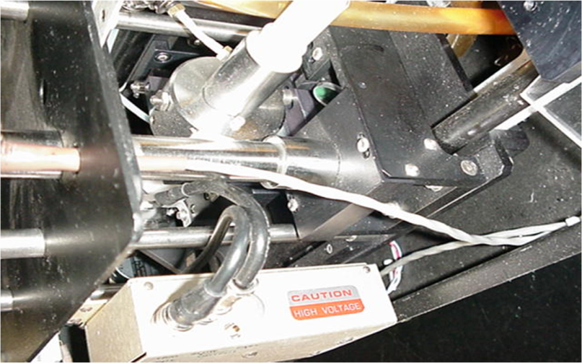





Non-Beam Hazards
Electrical Hazard
High voltage risk
Eliminate contact with high voltage
Arrange for repairs
Lockout / Tagout
Inspect cords and plugs
Ground all equipment
Complete training
32
Notes:
Many lasers have high voltage power supplies that can present a risk of electrocution unless sufficient care is taken when servicing them. Thus, ensure that you eliminate any contact with high voltage equipment.
Do not perform electrical service or maintenance on a laser unless you are properly trained. Allow the experts, including the service representatives for the laser manufacturer, or the campus electricians, to make any necessary repairs.
When there are known issues with equipment, lockout or tagout the equipment until it is safe to use.
Make sure that you inspect cords, plugs, and accessories for missing or damaged wiring. Look for shorts and overheated components. Do not overload circuits / outlets, place near water, or wear metal objects around electrical equipment.
Ground all equipment and complete training in basic electrical safety.
If personnel in your work area are working with high voltage power supplies, then Environmental Health & Safety recommends that you take a First Aid and CPR class.

Slide 33




Non-Beam Hazards
Electrocution
Emergency Procedures
Kill the circuit
Call 911
Use nonconductor to remove victim
Initiate CPR (if trained)
33
Notes:
If you should witness someone being electrocuted, take the following actions.
First, kill the circuit if you are able to do so safely. This involves pulling the plug on the laser system or other energized device. Arrange for someone to call 911. Then, remove the victim from the circuitry using a non-conducting material (such as a wooden broom handle). Then initiate CPR, but ONLY if you are trained. Untrained persons can do more harm than good.

Slide 34










Non-Beam Hazards
Chemical (Liquid)
Liquid phase dye lasers
are carcinogenic or mutagenic
Mix in fume hood
Wear PPE
Use secondary containment
Review MSDS
34
Notes:
Liquid phase dye lasers employ various dyes, some of which are carcinogenic or mutagenic. Therefore you must mix these dyes in a fume hood while wearing the appropriate personal protective equipment (which includes a laboratory coat, eye protection, and impermeable gloves). Dyes should be kept in secondary containment. Also, make sure you review the Safety Data Sheet for each hazardous chemical prior to mixing the solutions.

Slide 35


Non-Beam Hazards
Chemical (Gas)
Excimers involve use of
toxic fluorine or chlorine gas
Store in ventilated gas cabinets
Use halogen detection and alarm systems or halogen gas scrubbers in rare cases
35
Notes:
Excimer lasers involve the use of fluorine or chlorine gas, both of which are very toxic. These gases need to be stored in approved ventilated gas cabinets. In some cases, halogen detection and alarm systems, or halogen gas scrubbers must be used.

Slide 36

Non-Beam Hazards
Chemical (Gas)
Gases generate harmful
airborne contaminants
Prevent from inhaling
Ventilate adequately
Use local exhaust systems
36
Notes:
When a high power laser beam strikes certain surfaces or targets, it can vaporize the material and generate toxic gases and particulates into the air that can be harmful if inhaled. When using a high power beam, make sure that the laser area has either the ventilation rate necessary to reduce pollutants to safe levels, or local exhaust systems to remove pollutants altogether.

Slide 37







Non-Beam Hazards
Fire Hazard
Explosions and Radiation
Separate flammables
Construct with fire resistant materials
Keep fire extinguishers nearby
Shield against radiation
(X-ray, Plasma, RF, and Microwaves)
37
Notes:
To avoid fires keep flammable chemicals and ignitable materials well away from high power laser beams. Beam enclosures, barriers, and other components need to be made of fire resistant materials. Ensure that there are fire extinguishers nearby and that people in the laboratory know how to operate them. Protect against collateral radiation by shielding against x-rays, plasma radiation, RF, and microwaves.

Slide 38




Engineering Controls
Eliminate exposure
Use physical structures
as your first line of defense
Protective housing
Interlocks
Aperture beam blocks
Warning lights
Protective
Housing
Interlock
Warning Light
Laser
Beam Block
38
Notes:
Engineering controls are physical structures that eliminate, or reduce, your exposure to dangers such as electrical and optical hazards. They are the first line of defense.
Some engineering controls are required to be installed by the laser manufacturer. This includes protective housing, interlocks (and automatic cut-off switches), aperture beam blocks / shutters / attenuators, and warning lights.

Slide 39

Engineering Controls
Use beam attenuators on high powered lasers:
  Class 3B
  Class 4
39
Notes:
Another engineering control is known as a beam attenuator. These are mechanical devices designed to decrease the power per unit area of laser beams through absorption and scattering of the beam. Because it blocks bodily access to high laser radiation levels (without the need to turn off the laser), these devices are required for Class 3B and Class 4 lasers.

Slide 40




Engineering Controls
Fire Extinguisher
Interlock
to laser or shutter
Warning labels
on equipment
Storage
of eyewear protection
Laser curtain
at entry
Warning light
Controlled Access
to laser area
Warning sign
on door
40
Notes:
Other engineering controls are installed in the laboratory by laser users.
Access control is accomplished by installing locks or security systems such as keypads or security door cards.
Post warning signs in conspicuous areas to prevent unauthorized access.
Test warning lights to ensure that they provide an electronic signal when lasers are in use.
Contain lasers to a specific area using barriers such as a laser safety curtain. Place these curtains at entryways to limit exposures greater than the Maximum Permissible Exposure limit.
Create a storage place for personal protective equipment, such as safety eyewear, near the entryway.
Ensure warning labels are affixed onto the equipment itself, beginning with Class 2 and Class 2M lasers.
Interlock interfaces are the primary means of arming and disarming laser interlocks, and should be placed near the laser table. Finally, ensure that fire extinguishers are placed within reach in case of an emergency.

Slide 41





Administrative Controls
Identify hazards with signs & labels
Complete
training
Restrict access
Obtain permission
Minimize risk by observing
policies and requirements
41
Notes:
Administrative controls are your second line of defense against laser hazards. These controls focus mostly on policies and requirements that enable people to conduct their jobs safely. They are requirements that are imposed upon people, such as ensuring that all individuals complete Laser Safety training prior to working with, or around, lasers. In addition to this training course, ensure that hands-on training is completed. Minimize risk by restricting access to areas where lasers are used. Additionally, ensure that you obtain the proper permission to work with lasers by registering your laser machine with EH&S. Additionally, ensure that you post the proper warning signs and labels to identify the hazards that are present.

Slide 42






Administrative Controls
NOTICE sign
Alignment, installation, or repair in progress.
Injury possible.
CAUTION sign
Strong lasers (Class 2, 2M)
Eye damage possible.
DANGER sign
High powered lasers (Class 3B, 3R, 4)
Eye damage (permanent) or burn possible.
42
42
Notes:
Make sure to install the appropriate warning signs on the walls or doors where lasers are present. There are three signs that have
different messages.
Notice signs indicate that alignment, installation, repair, or servicing of lasers is in progress; which may result in injury.
Caution signs indicate that strong lasers may be in use (Class 2, 2M); which may result in eye damage from extended exposures.
Danger signs indicate that high powered lasers may be in use (Class 3B, 3R, 4); which may result in permanent eye damage or burns.
It is your responsibility to be familiar with what these laser signs mean, and to contact the Principal Investigator responsible for the room prior to entering. Injuries may result if you enter the room without proper training.

Slide 43

What do you think?
Which sign indicates presence of a Class 2 laser?
43
Notes:
You are working on a Class 2 laser. Which of these signs should be put up to indicate the presence of a working Class 2 laser?

Slide 44

Use a CAUTION sign (yellow) to indicate presence of Class 2 or Class 2M lasers.
Low-powered lasers
44
Notes:
(Yellow) caution signs should be posted to indicate presence of Class 2 and 2M lasers.

Slide 45
What do you think?
Which sign indicates that an area is under temporary control for service?
45
Notes:
You are working on aligning one of the lasers in his laboratory. Which of these signs should be put up to indicate that his area is under temporary control for service?

Slide 46


Indicate that an area is under temporary control for service using a NOTICE sign (blue / white).
alignment
repair
46
Notes:
(Blue/white) notice signs should be used to indicate that an area is under temporary control due to servicing of lasers, such as during alignment or repair.

Slide 47
What do you think?
Which sign indicates the presence of a high-powered laser?
47
Notes:
You are working on a Class 3B laser. Which of these signs should be put up to indicate the presence of a working high-powered laser?

Slide 48


Use a DANGER sign (red/white) to indicate presence of a high-powered laser.
Class 3B
Class 4
48
Notes:
(Red/white) Danger signs should be used to indicate the presence of high-powered lasers such as Class 3B and Class 4.

Slide 49



Administrative Controls
Training
Forms
Guidelines
Laser Safety Training
(every 3 years)
First Aid / CPR
(recommended)
Laser Registration
SOP (template)
Laser Safety Manual
SOP
Alignment procedures
49
Notes:
There are important administrative controls that requires the completion of training, forms for approval, and implementation of guidelines that ensure safety.
All users of Class 3B and Class 4 lasers should make sure they complete laser safety training before working with lasers, and every 3 years. In addition, it is recommended that laser users take First Aid / CPR training in case of an accident.
Principle Investigators are responsible for registering all lasers, regardless of class, using the laser registration application form with Environmental Health & Safety. If working with Class 4 lasers, a PI will also need to develop a laboratory site-specific SOP associated SOP.
Finally, all users are required to follow the guidelines in the NJIT Laser Safety Manual. They must also adhere to all SOPs and alignment procedures associated with Class 3B or higher lasers.

Slide 50




Administrative Controls
Never leave unattended
Follow procedures
Isolate laser operations
50
Notes:
Overall, make sure to follow safe procedures, keep laser operations well isolated from high traffic areas, and never leave an operating laser unattended.

Slide 51

Work Practices
Implement
safe ways of performing
your tasks

Slide 52

What do you think?
When do most injuries occur when working with lasers?
When turning on
electricity
During
installation
When turning off
electricity
During
alignment
52
Notes:
When do the most injuries occur when working with lasers?

Slide 53

Follow safe work practices during alignment of lasers
During
alignment
53
Notes:
Over 60% of incidents occur during alignment procedures. Most go unreported during the critical first 24-48 hours post exposure. Therefore, take care to follow safe work practices during alignment of lasers.

Slide 54














Alignment
Janette
54
Notes:
An alignment is a tune-up procedure, often required for “beam out of the box” devices. Examples of safe ways of performing alignment include:
Remove metal jewelry, watches, and badges before beginning any activities
Prepare all equipment and materials prior to beginning
Use non-reflective tools
Arrange for someone else to be present
Remove unnecessary equipment, tools, and combustible material to minimize the possibility of stray reflections and non-beam accidents.
Make sure to keep objects out of the beam.

Slide 55








Alignment
55
Notes:
Other examples of work practices include:
Wear PPE at all times during operation, and when a Class 1 laser enclosure is open.
Reduce the beam power using filters, beam splitters and dumps, or the lowest possible power supply. Avoid using high-power during alignment.
Label the areas where the beam leaves the horizontal plane.
Work around (or avoid) beam paths that are at sitting or standing eye level. Direct beam away from eye level, and keep body parts out of the beam path.
Simulate the beam path using lower power visible lasers.
Terminate any stray or unused beams. Use beam shutters to block high power beams any time they aren't needed. Terminate the beam at the end of its useful path. Eliminate all beams and reflections prior to high power operation.
View invisible beams with IR/UV cards or sensor cards; taking care to avoid specular reflections off of some of these materials.
Do not look directly at the beam! You can prevent from intentional intra-beam viewing with the eye by using cameras or fluorescent devices to view the beam.

Slide 56

What do you think?
What is an example of a safe work practice around an embedded laser?
Embedded Laser
Access with
a hammer
Ignore safety locks
when opening
Wear eye
protection
Bypass protective
housing for service
56
Notes:
This is an example of an embedded laser. (Other examples of embedded lasers are confocal microscopes, or mass spectrophotometer). Embedded lasers usually have an exterior with a lower class laser label. However, as you can see, on the inside of this product there is a higher class labeled laser incorporated.

Slide 57

Wear eye protection appropriate for a high-powered laser when working with embedded lasers.
Embedded Laser
Wear eye
protection
57
Notes:
You should always wear eye protection appropriate for a high-powered laser, such as that required for a Class 3B or Class 4 laser, when working with embedded lasers.

Slide 58

Personal Protective Equipment
PPE
The strategy of last resort.
Ensure proper fit and select the correct PPE for the job.
58
Notes:
Using Personal Protective Equipment (PPE) is another way of protecting yourself through the use of a physical barrier.Because there should be other controls implemented, PPE should be considered the strategy of last resort. This is mainly because there are problems that may arise from the use of PPE, such as incorrect fit, use of the wrong PPE for the job, use of damaged or poorly maintained PPE, or inconsistent PPE use.

Slide 59






What do you think?
Which safety eyewear can protect against lasers?
59
Notes:
Safety eyewear is one of the most important PPE’s you can wear. But not all have the same protection. Which safety eyewear can help protect your eyes against lasers?

Slide 60


Use safety eyewear that protects against optical radiation through neutral density, bandpass, or cut-off lens filters and side shields.
Neutral density
absorbs and reflects
Bandpass
transmits weaker light
Cut-off
blocks light at one end
60
Notes:
Safety eyewear that protects against optical radiation can shield the eye from laser beams. This is accomplished through special lens that allow the light to be absorbed (such as neutral density lenses), transmitted at a lower level (such as bandpass lenses), or simply blocked at one of the of the electromagnetic spectrum (such as cut-off lenses). Also, make sure to wear the appropriate laser safety eyewear to protect against specular or diffuse reflections.

Slide 61

Eye protection
Select based on wavelength
KTP
(532 nm)
Ruby
(694 nm)
Argon
(488 nm and 514 nm)
Nd:YAG
(1060 nm)
Ultraviolet
Visible
Infrared
61
Notes:
But not all laser eye protection is the same. The kind of lens you use should be based on the wavelength of the laser you’re working with.
The wavelengths of lasers place them on different parts of the electromagnetic spectrum. For example, argon lasers tend to have shorter wavelengths of 488 nm, while Neodymium Yag (Nd:YAG) lasers will have a longer wavelength of at least 1050 nm.
Approved laser safety eyewear is labeled with information about the wavelength that it can help protect you against. This information is generally labeled on the lens itself.

Slide 62


What do you think?
Which will provide minimum protection during use of a solid state
Ruby laser (694 nm)?
Ruby
(694 nm)
Ultraviolet
Visible
Infrared
689 nm – 782 nm
190 nm – 532 nm
5,000 nm – 11,000 nm
62
Notes:
You need to protect your eyes during use of a solid state Ruby laser at a wavelength of 694 nm. Which laser eyewear gives you
the minimum protection you need?

Slide 63
Use eye protection that is adequate for the wavelength you
are working with.
Ruby
(694 nm)
Ultraviolet
Visible
Infrared
689 nm – 782 nm
63
Notes:
This laser safety eyewear provides protection against lasers with wavelengths between 689 – 782 nm. Since the solid-state Ruby
laser being used has a wavelength of 694 nm.
Example: Ruby, Krypton, CO₂, and excimer laser: OD 7 @ 689-782 nm; OD 5 @ 681-789 nm

Slide 64

Optical Density
100%
transmission
Optical Density (OD)
Light transmission
OD = 0
0
1
2
3
4
5
6
7
8
  100 %
  10
  1
  0.10
  0.01
  0.001
  0.0001
  0.00001
  0.000001
10%
transmission
OD = 1
1%
transmission
OD = 2
64
Notes:
The ability of a lens to filter out a laser’s wavelength is called its optical density (OD).
The relationship between optical density and the amount of light that is transmitted is shown in this table. For example, a safety eyewear that has no optical density ability (such as in regular prescription glasses) will allow 100% of light to pass through its lens. If the lens, however, was treated and it was rated with an optical density of 1, then only 10% of the light will pass through. If it had an optical density of 2, then only 1% of the laser beam would pass through…and so on.

Slide 65



Optical Density
100%
transmission
Optical Density (OD)
Light transmission
0
1
2
3
4
5
6
7
8
  100 %
  10
  1
  0.10
  0.01
  0.001
  0.0001
  0.00001
  0.000001
10%
transmission
1%
transmission
65
Notes:
In practical terms, this means that an optical density that’s too high may restrict your ability to see your work…and you’ll have trouble pointing or aiming your laser. An optical density that’s too low allows too much of the laser to pass through, and can damage your eyes. So how much light transmission is safe to be exposed to? Is it 10% or 1 millionth of a percent (0.0001)? In other words, how do you know which Optical Density rating to choose?

Slide 66


Optical Density
Output
power
Optical Density (OD)
Light transmission
0
10
100
1,000
10,000
100,000
1,000,000
10,000,000
100,000,000
mW
0
1
2
3
4
5
6
7
8
  100 %
  10
  1
  0.10
  0.01
  0.001
  0.0001
  0.00001
  0.000001
66
Notes:
The minimum optical density rating you should choose depends on how much power or energy your laser produces. For example, this sign indicates the presence of a class 3B laser with a maximum output power of 25 mW. This output power exceeds an optical density of 1, but can be used with safety eyewear that has an optical density of at least 2.

Slide 67
Optical Density
Optical Density (OD)
Light transmission
0
1
2
3
4
5
6
7
8
  100 %
  10
  1
  0.10
  0.01
  0.001
  0.0001
  0.00001
  0.000001
67
Notes:
Similar to the wavelength, laser safety eyewear is labeled with the optical density appropriate for its use, as shown in this example.
This particular eye protection can be used with infrared light. If used with lasers with wavelengths between 800-839 nm, this eye protection will allow you to see one-tenth of a percent of the laser beam, since it has an optical density of 3.

Slide 68



What do you think?
Which safety eyewear can
protect against lasers with
a wavelength of 930 nm ?
OD 6 @ 457-515 nm
OD 3 @ 515-530 nm
OD 5 @ 585-600 nm
OD 6 @ 600-605 nm
I need an OD of 6
OD 5 @1065-1100
OD 6 @ 800-980
OD 7 @ 980-1065
68
Notes:
Some eyewear is designed to protect against several types of lasers. The optical density curves shown here demonstrates protection across different laser ranges.
You have determined that you need a high optical density of 6 to use with a laser that has a wavelength of 930 nm. Which safety eyewear can provide you the protection you need?

Slide 69
Select laser safety eyewear based on the optical density and wavelength of your laser.
I need an OD of 6
OD 5 @1065-1100
OD 6 @ 800-980
OD 7 @ 980-1065
69
Notes:
The safety eyewear is labeled with the correct optical density of “6”, and can sufficiently protect against a wavelength of “930 nm”.

Slide 70
Select laser safety eyewear based on the optical density and wavelength of your laser.
KTP
(532 nm)
Argon
(488 nm and 514 nm)
Nd:YAG
(1060 nm)
Ultraviolet
Visible
Infrared
70
Notes:
In general, orange eyewear is commonly used for protection against blue and green laser beams, such as the gas-ion argon and krypton lasers. Green eyewear is typically used for protection against high-powered lasers, such as solid state Nd:YAG, gas-ion argon, and excimer lasers.

Slide 71


Select laser safety eyewear based on the optical density and wavelength of your laser.
In addition to…
  Fit
  Field of Vision Prescription
  Sensor Card Use
  Degradation
Too much space
Proper fit
71
Notes:
In addition to the optical density and wavelength, make sure to select safety eyewear based on proper fit, field of vision, whether prescriptive lenses are required, whether they allow you to see the glow on sensor cards (if used), and the possibility of degradation (such as photo-bleaching).

Slide 72
Summary
Determine laser classes and components
Identify hazards
Biological
Non-Beam
Implement controls
Engineering
Administrative
Work Practice
PPE
72
Notes:
As a reminder, ensure that you:
Differentiate between laser classes and the different parts of a laser
Identify hazards (including both the biological effects of lasers, as well as the non-beam dangers presented), and
Implement controls (including engineering and administrative controls, good work practices, and the use of PPE

Slide 73
www.osha.gov/SLTC/laserhazards
ANSI Z136 series of laser safety standards
LIA.org Laser Institute of America rli.com rockwell laser institute
References

