Slide 1
A Report from the ad hoc Committee on the Establishment of an NJIT Branch Campus in Egypt
Cesar Bandera MTSM
Ian Gatley CSLA
Scott Kent CSLA
Mathew Schwartz HCAD
Raj Sodhi NCE
Margarita Vinnikov YWCC
Zhipeng (Alan) Yan MTSM

Slide 2
At a Meeting in April (4-20-21), President Bloom told Faculty Senate that NJIT will open a campus in Egypt:
In 2018 Egypt passed statute Law No. 162/2018
inviting international universities to partner with development companies identified by the Egyptian government to establish International Branch Campuses in Egypt…
In response to this opportunity NJIT has partnered with Tatweer Misr, an Egyptian investments and land reclamation company, to build and operate an IBC.
The Egyptian Minister of Higher Education has issued the necessary authorizations for NJIT and Tatweer Misr to proceed with their joint partnership.
The plan is to offer courses beginning possibly Fall 2022, but no later than Fall 2023.

Slide 3
At a Meeting in April (4-20-21), President Bloom told Faculty Senate that NJIT will open a campus in Egypt:
In 2018 Egypt passed statute Law No. 162/2018
inviting international universities to partner with development companies identified by the Egyptian government to establish International Branch Campuses in Egypt…
In response to this opportunity NJIT has partnered with Tatweer Misr, an Egyptian investments and land reclamation company, to build and operate an International Branch Campus.
The Egyptian Minister of Higher Education has issued the necessary authorizations for NJIT and Tatweer Misr to proceed with their joint partnership.
The plan is to offer courses beginning possibly Fall 2022, but no later than Fall 2023.

Slide 4
At a Meeting in April (4-20-21), President Bloom told Faculty Senate that NJIT will open a campus in Egypt:
In 2018 Egypt passed statute Law No. 162/2018
inviting international universities to partner with development companies identified by the Egyptian government to establish International Branch Campuses in Egypt…
In response to this opportunity NJIT has partnered with Tatweer Misr, an Egyptian investments and land reclamation company, to build and operate an IBC.
The Egyptian Minister of Higher Education has issued the necessary authorizations for NJIT and Tatweer Misr to proceed with their joint partnership.
The plan is to offer courses beginning possibly Fall 2022, but no later than Fall 2023.

Slide 5
At a Meeting in April (4-20-21), President Bloom told Faculty Senate that NJIT will open a campus in Egypt:
In 2018 Egypt passed statute Law No. 162/2018
inviting international universities to partner with development companies identified by the Egyptian government to establish International Branch Campuses in Egypt…
In response to this opportunity NJIT has partnered with Tatweer Misr, an Egyptian investments and land reclamation company, to build and operate an IBC.
The Egyptian Minister of Higher Education has issued the necessary authorizations for NJIT and Tatweer Misr to proceed with their joint partnership.
The plan is to offer courses beginning possibly Fall 2022, but no later than Fall 2023.

Slide 6
Ad hoc Committee
At the end of spring semester Faculty Senate moved to form an ad hoc committee
The committee met weekly during the summer
Studied documents, talked with colleagues, met with administrators

Slide 7
Ad hoc Committee
At the end of spring semester Faculty Senate moved to form an ad hoc committee
The committee met weekly during the summer
Studied documents, talked with colleagues, met with administrators
Identified three recurrent themes to be reported today
Faculty at the branch campus
Awarding of degrees
Accreditation

Slide 8
Background: NJIT Engages with the Opportunity in Egypt

Slide 9

Egypt Vision 2030
https://www.arabdevelopmentportal.com/sites/default/files/publication/sds_egypt_vision_2030.pdf

Slide 10

Egypt Vision 2030: Main Pillars

Slide 11
NJIT Began Thinking About Egypt Because of An Invitation from Ocean County College
OCC invited NJIT to team to create a program in Egypt .
OCC has established programs,

Slide 12
NJIT Began Thinking About Egypt Because of An Invitation from Ocean County College
OCC invited NJIT to team to create a program in Egypt .
OCC has established programs, for example this 3-way:
OCC provides online courses to selected Ain Shams University students in the first two years of their undergraduate studies. The students also take face-to-face courses from Ain Shams faculty.
For the last year of their program students join Kean University, take Kean’s online courses, and earn a bachelor’s degree from Kean’s business program. Students also continue to register for face-to-face business courses given by Ain Shams faculty and earn a bachelor’s degree in business from Ain Shams University.

Slide 13
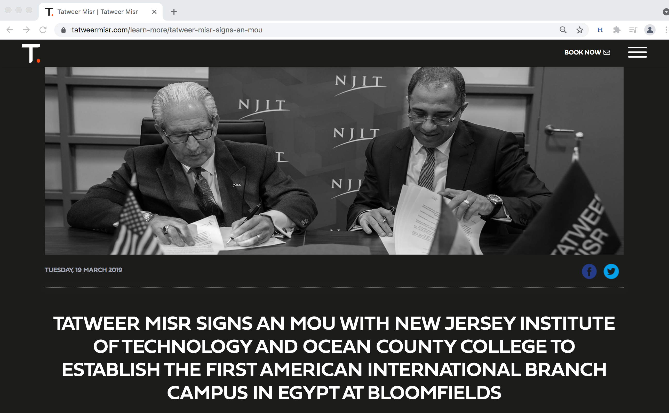

Slide 14
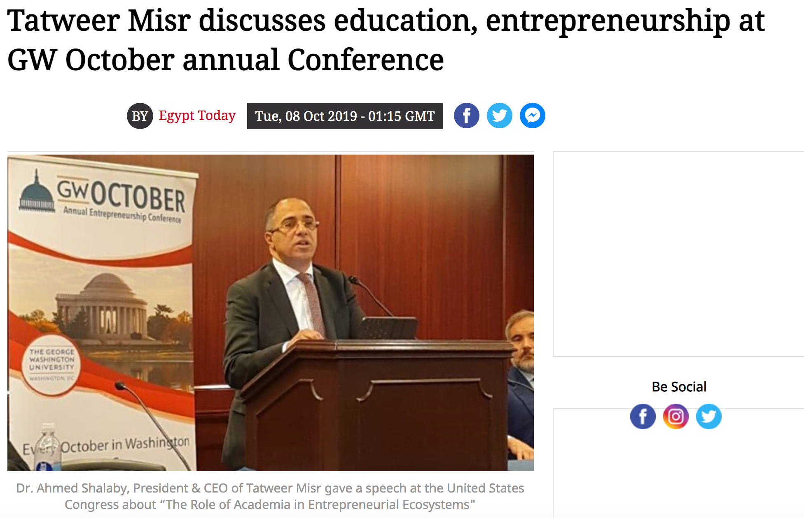
https://www.egypttoday.com/Article/6/75604/Tatweer-Misr-discusses-education-entrepreneurship-at-GW-October-annual-Conference

Slide 15
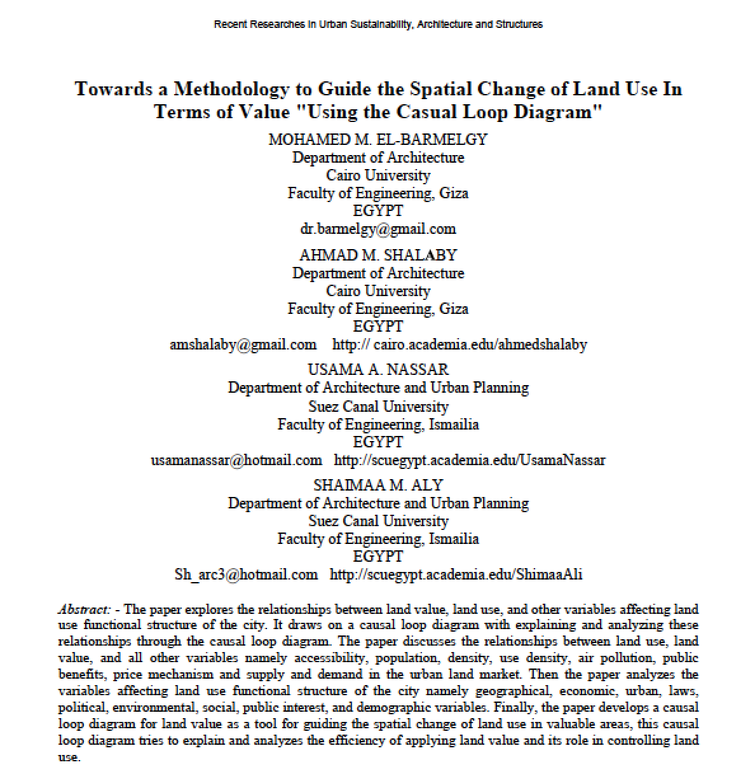

Slide 16
Dr. Ahmed Shalaby, President & CEO of Tatweer Misr, 2019
“Ever since our inception, we have dedicated most of our social investment efforts towards fostering an entrepreneurial mindset among Egyptian university students, as well as building a vibrant entrepreneurial ecosystem across Egypt, and with universities as a starting point.”
https://www.egypttoday.com/Article/6/75604/Tatweer-Misr-discusses-education-entrepreneurship-at-GW-October-annual-Conference

Slide 17
Dr. Ahmed Shalaby, President & CEO of Tatweer Misr, 2019
“Tatweer Misr collaborated with New Jersey Institute of Technology (NJIT) with the sole purpose of creating an unprecedented grass-root movement to support entrepreneurial education with quality as their utmost priority, as it represents Egypt’s first American International Branch Campus (IBC).
https://www.egypttoday.com/Article/6/75604/Tatweer-Misr-discusses-education-entrepreneurship-at-GW-October-annual-Conference

Slide 18
Dr. Ahmed Shalaby, President & CEO of Tatweer Misr, 2019
“Tatweer Misr collaborated with New Jersey Institute of Technology (NJIT) with the sole purpose of creating an unprecedented grass-root movement to support entrepreneurial education with quality as their utmost priority, as it represents Egypt’s first American International Branch Campus (IBC).
“Moreover, Tatweer Misr plans to build on that momentum by continuing to partner with internationally acclaimed universities and schools, bringing them to Egypt to span across their 90-acre educational district at its new project, Bloomfields.”
https://www.egypttoday.com/Article/6/75604/Tatweer-Misr-discusses-education-entrepreneurship-at-GW-October-annual-Conference

Slide 19


Slide 20


Slide 21
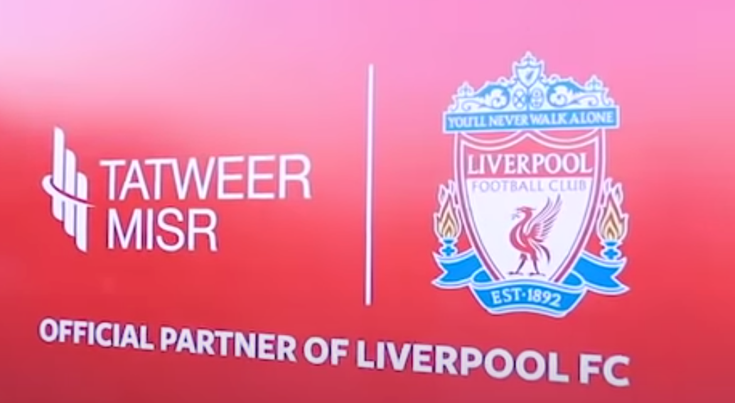
https://www.youtube.com/watch?v=kbaU7yZSCrQ

Slide 22

https://www.youtube.com/watch?v=kbaU7yZSCrQ

Slide 23

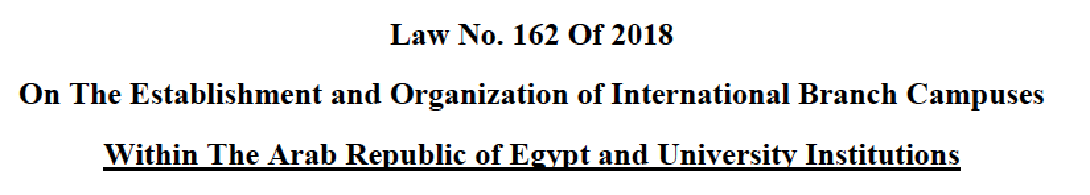
Law

Slide 24
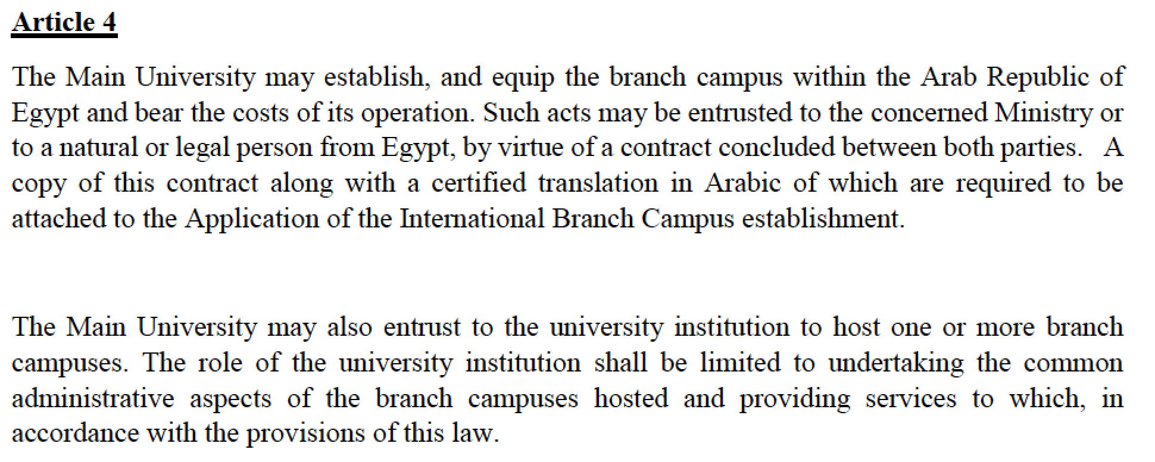
The Law Provides More Than One Way to Establish a Branch Campus

Slide 25
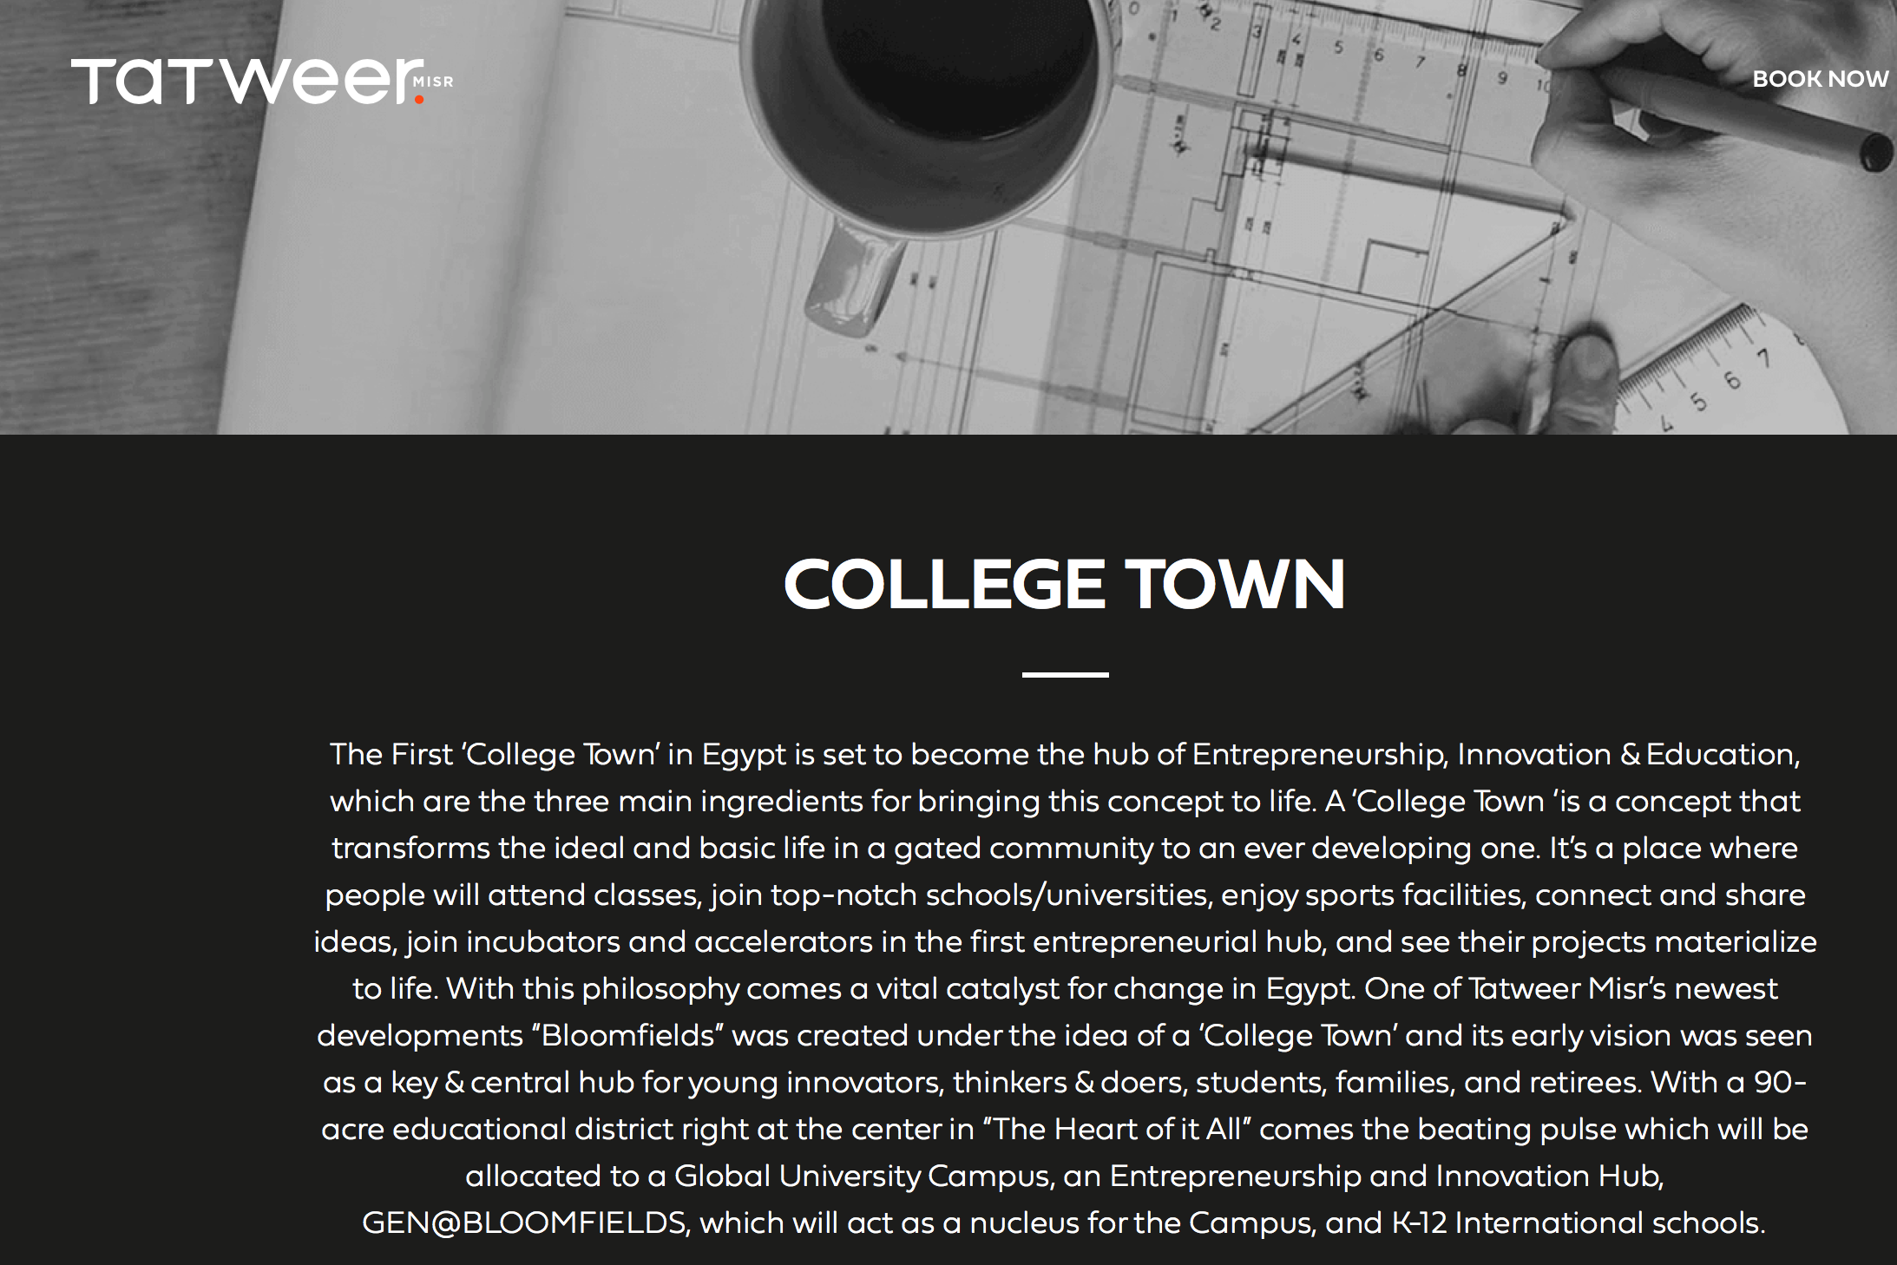
https://tatweermisr.com/education

Slide 26

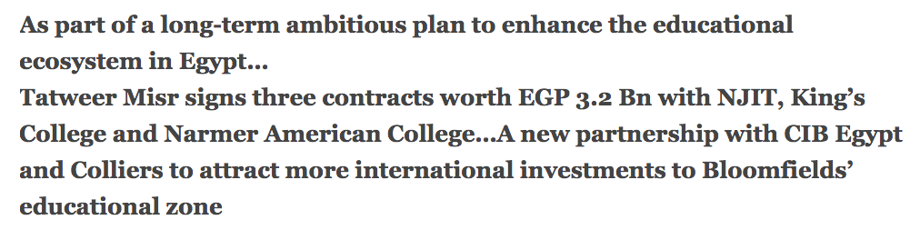

Slide 27
NJIT Partnership with Tatweer Misr
NJIT has no financial obligation for the establishment or operation of the campus, including for the instructional, student support services, or any other personnel.
In fact, all personnel will be employees of the Tatweer Misr Education Institute (TMEI), except for the campus leader
an NJIT Vice Provost/Campus President will be an NJIT employee.
From: Q&A for the Establishment of an NJIT Branch Campus in Egypt
by President Joel Bloom 5-6-21

Slide 28
RESOLUTION AUTHORIZING AGREEMENT BETWEEN NEW JERSEY INSTITUTE OF TECHNOLOGY (“NJIT”) AND TATWEER MISR FOR TOURISTIC AND LAND RECLAMATION (“TMT”)
WHEREAS, NJIT’s Strategic Plan, “Building on a Strong Foundation, 2025” includes the strategy of “Global NJIT”,
to increase enrollment and research growth,
business development and revenue generation, as well as
increased visibility and building NJIT’s
international reputation;
April 1, 2021
Board Resolution No. 2021-24
https://www5.njit.edu/boards/sites/boards/files/Tatweer%20-NJIT%20Touristc%20%26%20Land%20Reclamation%204-1-21.pdf

Slide 29
RESOLUTION AUTHORIZING AGREEMENT BETWEEN NEW JERSEY INSTITUTE OF TECHNOLOGY (“NJIT”) AND TATWEER MISR FOR TOURISTIC AND LAND RECLAMATION (“TMT”)
WHEREAS, NJIT has jointly developed a business plan with TMT and Collier’s
for the provision of eight (8) degree programs in the disciplines of Engineering Technology, Information Technology, Management and Business, Architecture and Civil Engineering,
with future opportunities for additional undergraduate and Masters’ degree programs, as well as noncredit (executive education) programs and business development;
April 1, 2021
Board Resolution No. 2021-24

Slide 30
RESOLUTION AUTHORIZING AGREEMENT BETWEEN NEW JERSEY INSTITUTE OF TECHNOLOGY (“NJIT”) AND TATWEER MISR FOR TOURISTIC AND LAND RECLAMATION (“TMT”)
WHEREAS, such plan provides that NJIT will be hosted on a campus to be established in Egypt’s City of Mostakbal, Bloomfield’s,
that will be developed, built and operated by and at the sole cost of TMT,
providing the in-country administrative support, instructional spaces, equipment, maintenance, security, marketing, student recruiting and record keeping, financial and legal services;
April 1, 2021
Board Resolution No. 2021-24

Slide 31
RESOLUTION AUTHORIZING AGREEMENT BETWEEN NEW JERSEY INSTITUTE OF TECHNOLOGY (“NJIT”) AND TATWEER MISR FOR TOURISTIC AND LAND RECLAMATION (“TMT”)
WHEREAS, NJIT will be responsible under the plan for providing the instructional degree programs,
including qualified faculty and instructional staff, to teach both in the on-line format as well as in-person, to the same standards as its home campus;
April 1, 2021
Board Resolution No. 2021-24

Slide 32
RESOLUTION AUTHORIZING AGREEMENT BETWEEN NEW JERSEY INSTITUTE OF TECHNOLOGY (“NJIT”) AND TATWEER MISR FOR TOURISTIC AND LAND RECLAMATION (“TMT”)
NOW THEREFORE, BE IT RESOLVED THAT:
1. The Board authorizes NJIT, through its designated officials and administrators to sign the Agreement for the Establishment and Operation of Branch Campus between Tatweer Misr for Touristic Investments and Land Reclamation (Egypt) and New Jersey Institute of Technology and to execute all related documents necessary to effectuate the terms of the Agreement;
April 1, 2021
Board Resolution No. 2021-24

Slide 33
RESOLUTION AUTHORIZING AGREEMENT BETWEEN NEW JERSEY INSTITUTE OF TECHNOLOGY (“NJIT”) AND TATWEER MISR FOR TOURISTIC AND LAND RECLAMATION (“TMT”)
NOW THEREFORE, BE IT RESOLVED THAT:
2. The Board further authorizes NJIT, through its designated officials and administrators, to take all necessary and appropriate steps to make application to the Middle States Commission on Higher Education and the Office of the Secretary of Higher Education for the State of New Jersey and other accrediting bodies for accreditation approval for a branch campus as described and set forth in the above Agreement.
April 1, 2021
Board Resolution No. 2021-24

Slide 34
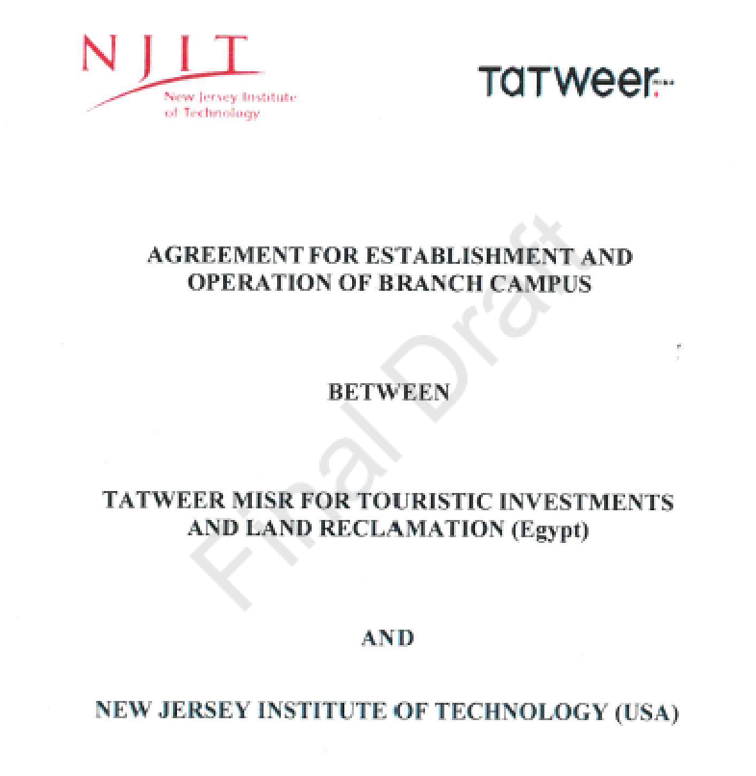

Slide 35
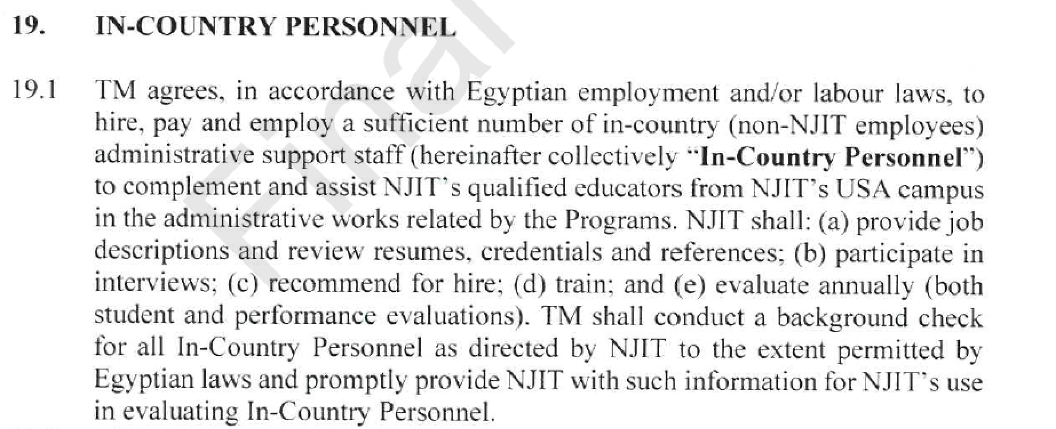

Slide 36
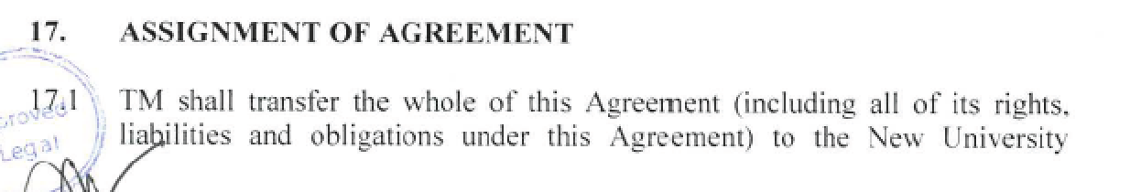
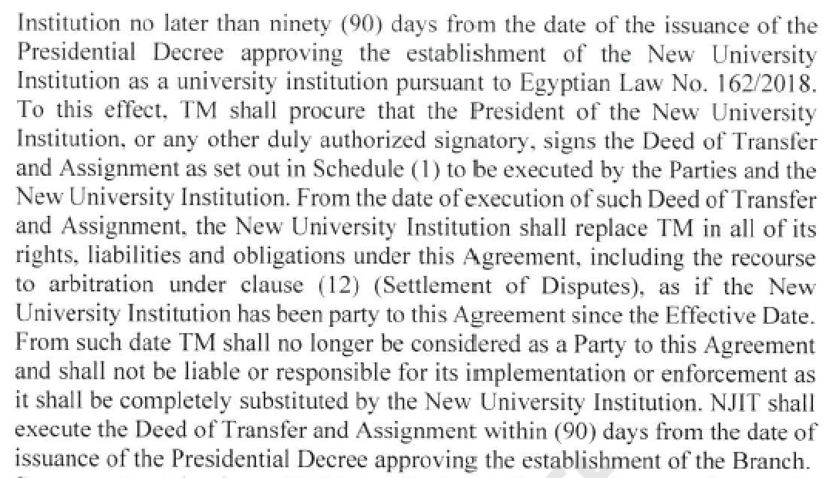
Th

Slide 37
Th

Slide 38
Th

Slide 39
WHEREAS, NJIT has jointly developed a business plan with TMT and Collier’s
Colliers International
April 1, 2021
Board Resolution No. 2021-24

Slide 40


Slide 41
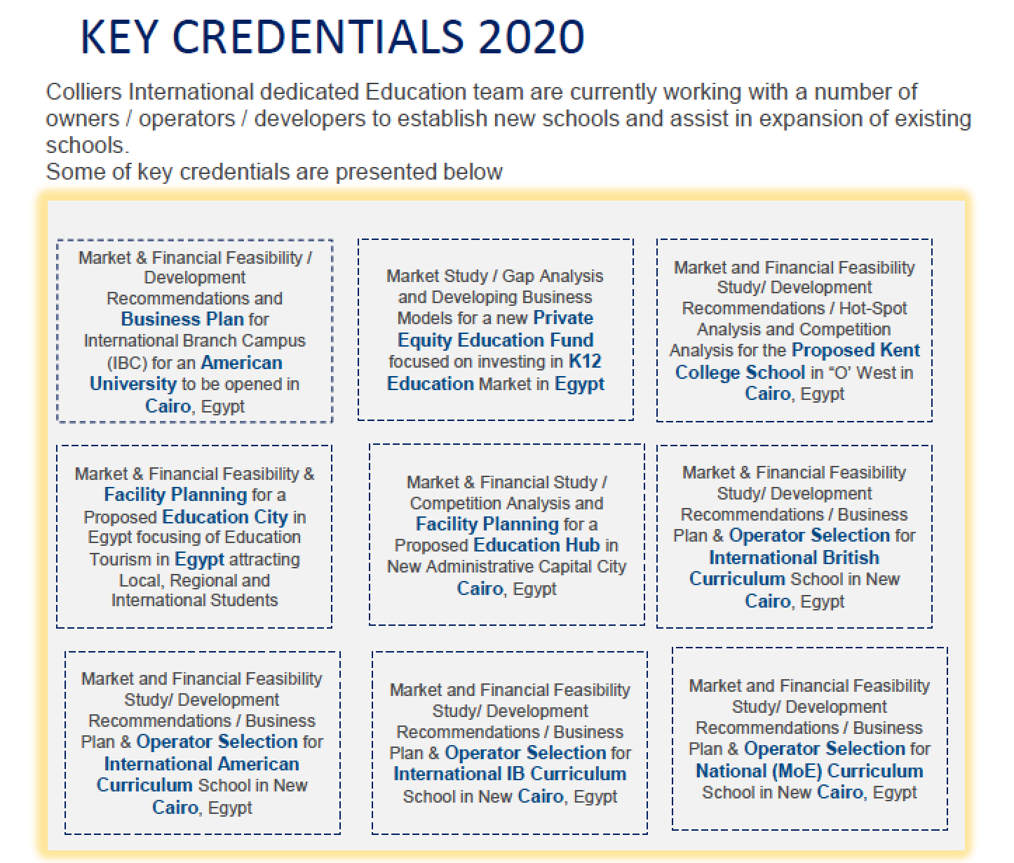

Slide 42
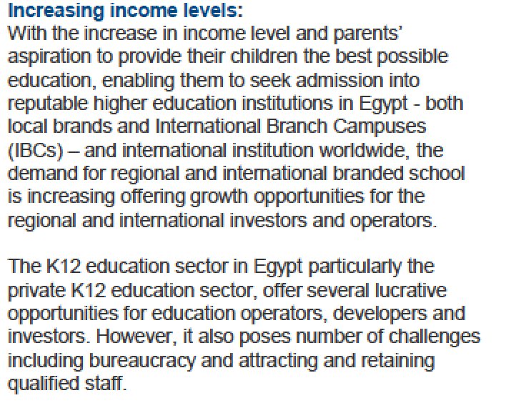
Opportunities and Challenges Identified by Colliers K-12 Report

Slide 43
NJIT Responsibilities in Operating a Branch Campus in Egypt

Slide 44
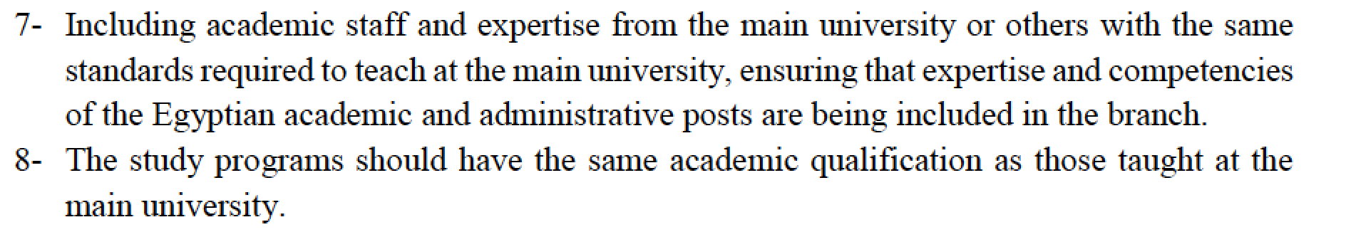
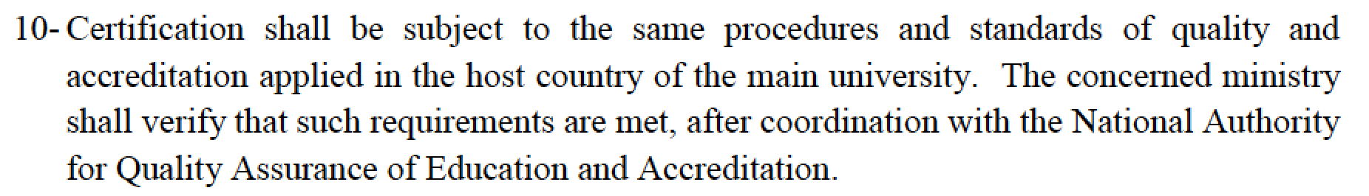
Operational Requirements from the Egyptian Law :

Slide 45
Operational Requirements from the Egyptian Law :

Slide 46
Operational Requirements from the Egyptian Law :

Slide 47
Faculty in Egypt

Slide 48
Number of Faculty

Slide 49
Faculty Recruitment, Evaluation, Promotion & Tenure
Most of the IBC faculty will be hired in Egypt
NJIT will be involved in the hiring process
All personnel will be employees of the Tatweer Misr Education Institute (TMEI)
The IBC faculty experience will be unlike that of the main campus faculty; for example
Hired under Egyptian law and labor practices
Working for a “for profit” enterprise
Therefore no expectation of faculty research (no startup funds; no labs)
No tenure: NJIT can only award tenure to NJIT employees
“Dotted line” reporting to the main campus departments

Slide 50
NJIT President
NJIT Branch Campus @ Egypt Organizational Chart
(NJIT BC@Egypt)
NJIT Provost & Senior Executive Vice President
Vice Provost/ President NJIT Branch Campus @ Egypt
NJIT CIO
Dean CSLA
Chief Operating
Officer
Dept. Head
Gen. Ed. Requirements
Advising & Tutoring
NJIT Chair
Computer Science
Library
Dept. Head
Computer Science
Campus Police
NJIT Chair
Applied Engin & Tech
IT
Student Support
Dept. Head
Engineering Technology
NJIT Director
Architecture
Administrative Staff
Career Services
Dept. Head
Architecture
Health & Counseling
NJIT Chair
Civil Engineering
Budget
International Students
Dept. Head
Civil Engineering
Student Affairs
NJIT Chair
Business
Registrar
Dept. Head
Business
Campus life
NJIT Chair
Informatics
Bursar/Financial Aid
Student Conduct
Dept. Head
Informatics
NJIT Vice Provost
Office of Research
Admissions & Communications
Research Admin & Support
Human Resources

Slide 51
Award of Degrees

Slide 52
Award of Degrees
The Egyptian law says, “The certificates awarded must be issued by the main university, having the same academic qualification as those awarded by counterpart faculties at the main university.”
This is being interpreted to mean that diplomas issued via the branch campus and the main campus will be indistinguishable

Slide 53
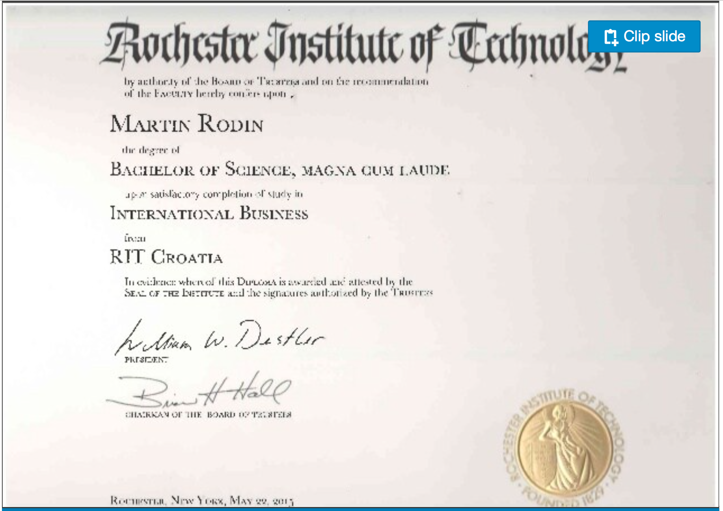
Does it have to be indistinguishable?
CROATIA

Slide 54
Accreditation

Slide 55
Accreditation
If the degrees are indistinguishable, there are inevitable implications for accreditation.
It’s impossible to have different accreditation status for a single, named NJIT degree.
The issue of faculty research expectation might also have accreditation implications
Faculty at Egypt will not be expected to conduct research

Slide 56

A branch campus is distinguished from an additional location by its level of independence.
Describe how the branch campus will operate independent of the main campus, controlling its own faculty, administrative or supervisory organization, budgetary and hiring authority.

Slide 57
Committee Recommendations

Slide 58
The ad hoc committee recommends that Faculty Senate consider:
The question of oversight of the International Branch Campus faculty members, regarding both their welfare and their performance
The implications of the specific form in which NJIT degrees are awarded to IBC students
The potential impact on accreditation of NJIT programs resulting from the details of the implementation model adopted for the International Branch Campus

Slide 59
Committee on Faculty Rights and Responsibilities
Charge and Purview
Monitor the rights, responsibilities, and status of faculty and instructional staff and make recommendations for changes in policies or procedures relating to them;… review and make recommendations about policy issues relating to faculty and instructional staff; review and make recommendations concerning issues relating to the quality of academic life for faculty and instructional staff, including course scheduling policies and procedures and opportunities for faculty development.

Slide 60
The ad hoc committee recommends that Faculty Senate consider:
The question of oversight of the International Branch Campus faculty members, regarding both their welfare and their performance
The implications of the specific form in which NJIT degrees are awarded to IBC students
The potential impact on accreditation of NJIT programs resulting from the details of the implementation model adopted for the International Branch Campus

Slide 61
A Motion to Faculty Senate
That Faculty Senate recommend to the NJIT administration that NJIT diplomas issued to students graduating from NJIT@Egypt must contain language identifying the fact that the student studied in Egypt.

Slide 62
The ad hoc committee recommends that Faculty Senate consider:
The question of oversight of the International Branch Campus faculty members, regarding both their welfare and their performance
The implications of the specific form in which NJIT degrees are awarded to IBC students
The potential impact on accreditation of NJIT programs resulting from the details of the implementation model adopted for the International Branch Campus

Slide 63
Committee on Academic Assessment
Charge and Purview
…serve as a resource for all academic units seeking information and support regarding assessment practices and procedures;
…manage the collection and utilization of assessment materials both on a regular basis and to meet specific needs, such as program, college/school, and university accreditation.

Slide 64
The ad hoc committee recommends that Faculty Senate consider:
The question of oversight of the International Branch Campus faculty members, regarding both their welfare and their performance
The implications of the specific form in which NJIT degrees are awarded to IBC students
The potential impact on accreditation of NJIT programs resulting from the details of the implementation model adopted for the International Branch Campus

