Slide 1
Balancing Time, School, Life
The Center for Academic and Personal Enrichment
New Jersey Institute of Technology
Notes:
1

Slide 2
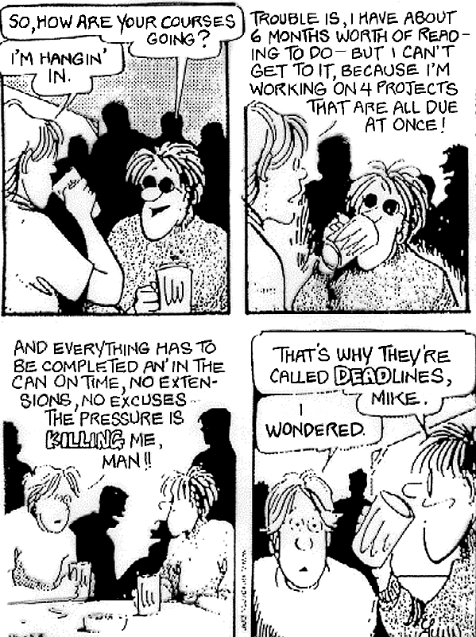
Notes:
4

Slide 3


Learning begins with discipline. The process of learning requires excellent time management. Academic success is inevitable with the combination of discipline and time management.

Slide 4
Time Management
Am I Getting Enough Sleep?
Conquer Procrastination
Pacing
Take the Offensive With a Planner
Be Realistic in your Expectations

Slide 5

Time is a Non Renewable Resource
  Once it is gone, it is gone.
  You will never see this moment again.

Slide 6
What’s your “LQ”
Leisure Quotient?
Sometimes we just don’t realize how much time we spend in non productive ways.
Here are some examples of leisure:
  Visiting between classes
  Facebook/Internet
  Watching TV
  Daydreaming
What others can you think of?

Slide 7
24 hours per day
X
60 minutes per hour
X
60 seconds per minute
=
86,400 Seconds

Slide 8
Every Second Counts
Spend every second in an efficient and productive way
If you fail to use the day’s deposits, the loss is yours.

Slide 9
Cognitive Tasks
8am - 12 noon*
Cognitive, or mental, tasks such as reading, calculating, and problem solving are performed most efficiently in the morning.
*If you are a Night Owl, shift these times about 3-4 hours later in the day.

Slide 10
Short term memory
6 am - 10 am
Short term memory tasks such as last minute reviewing for tests are best performed early in the morning.
*If you are a Night Owl, shift these times about 3-4 hours later in the day.

Slide 11
Long term memory
1 pm - 4pm*
Longer term Memory tasks such as memorizing speeches and information for application are best performed in the afternoon.
*If you are a Night Owl, shift these times about 3-4 hours later in the day.
Notes:
8

Slide 12
Manual Dexterity
2 pm to 6 pm*
You are most efficient at tasks involving the use of your hands such as keyboarding and carpentry in the afternoon and early evening.
*If you are a Night Owl, shift these times about 3-4 hours later in the day.

Slide 13
Physical Workouts
4 pm to 9 pm *
  Studies show you will perceive the workout to be easier in the evening.
  Exercising about 5 hours before bedtime improves the quality of sleep.
*If you are a Night Owl, shift these times about 3-4 hours later in the day.

Slide 14

ZZZZZ’s
Sleep is extremely important for your academic success.

Slide 15
Sleep Survey
During this semester, when did you MOST RECENTLY:
Wake up not feeling rested, no matter how much sleep you got?
in the last day week month this semester did not do
Doze off while studying?
in the last day week month this semester did not do
Doze off in a classroom or lecture hall?
in the last day week month this semester did not do
Doze off while watching TV?
in the last day week month this semester did not do
Doze off while sitting quietly in a public place (Library, Stamp Union, etc. )?
in the last day week month this semester did not do

Slide 16
Sleep Survey
If you knew more sleep would improve your health and memory, would you change your sleep habits?
Yes No

Slide 17
Student Lag, aka Jet Lag
Are you creating the equivalent of jet lag by keeping an inconsistent sleep schedule?
Answer the following questions to find out.

Slide 18
Do you Suffer from
Student Jet Lag?
Do you get up at about the the same time each morning?
Yes___No____
Do you wake up without an alarm most mornings?
Yes___No____
Do you almost always get 7-9 hours of sleep per night?
Yes___No____

Slide 19
Student Jet Lag
If you answered no to any of the questions, you are compromising your body’s efficiency.

Slide 20
How would prioritize this list of daily tasks?
Write the underlined word of the tasks which would be on your
“A” List
“B” List
“C” List
Immediately answer a text message from a friend.
Write a eight page essay for Humanities.
Prepare for a Biology quiz.
Dust your room.
Review for midterm test that counts for 50% of grade.
Schedule an appointment with a Professor.
Complete a journal entry.
Check your email every 10 minutes.
Shop for a new pair of athletic shoes.
Take the car for an oil change.
Notes:
10

Slide 21
MAKING LISTS
“A” LIST
  1 Midterm test that counts for 50% of grade.
  2 Write an eight page essay for Humanities.
“B” LIST
  3 Prepare for a quiz in Biology.
  4 Schedule an appointment with a Professor.
  5 Complete a journal entry.
“C” LIST
  6 Check your email regularly.
  7 Dust your room.
  8 Answer text messages from friends.
  9 Shop for a new pair of athletic shoes.
  10 . Take the car in for an oil change.
Notes:
11

Slide 22
“C” Fever
Have you ever noticed?
  You see a little dust that has to go before you can begin to study.
  There are so many distractions before you can get to your work.
If so, you may be suffering from “C” Fever

Slide 23
Conquer Procrastination
Why is “C” fever as common as the cold?
  The “A” tasks may :
    Produce minimal endorphins
    Be too lengthy
    Be too difficult
    Be too threatening because of the possibility of failure
    Be too threatening because of the possibility of success
Notes:
12

Slide 24
It’s All about Endorphins - The Feel Good Hormone
Develop a Conditioned Response to the Tasks you Procrastinate
Set a goal to complete a task/project
After completing the task, reward yourself with something that is pleasurable for you
The body releases endorphins- the feel good hormone
Over time with repetition, you will come to associate feeling good with completing a task/project
You won’t procrastinate as much

Slide 25
Pacing
Athletes know the phenomenon of running with someone ahead of them to increase their times.
The same effect can be achieved with studying and completing schoolwork.
Notes:
13

Slide 26
Because work expands or contracts to fit the time allotted, make pacing work for you by doing the following:
    Estimate the time needed to complete a task.
    Subtract 15% from that estimate.
    Set a timer to help you reach the goal of completing the task in reduced time.

Slide 27
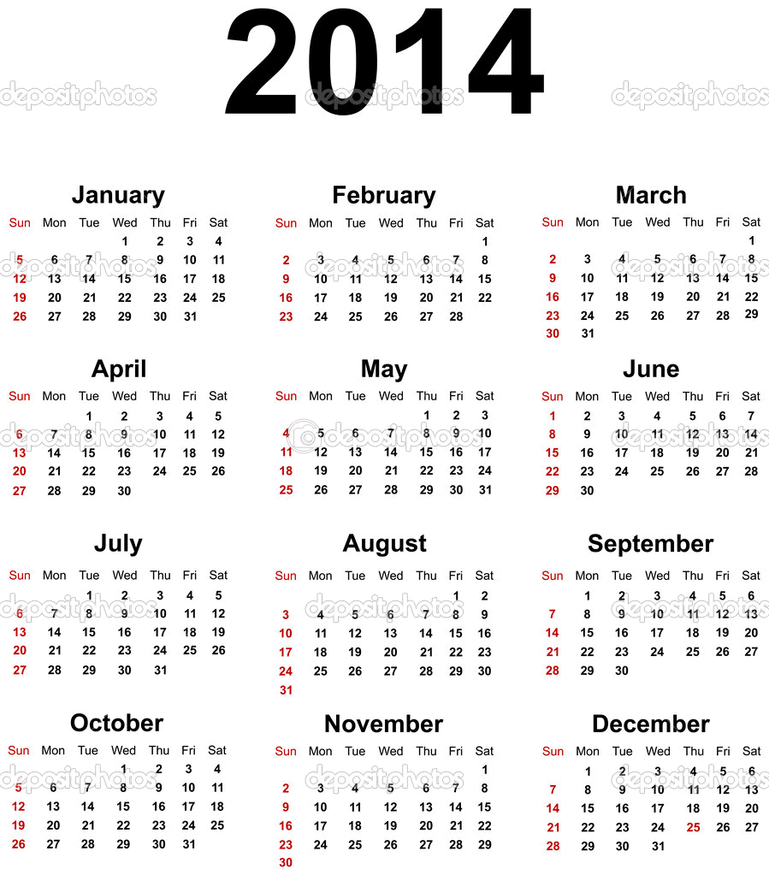
Take the Offensive with a
PLANNER
A planner helps you:
  See the big picture
  Plan ahead to avoid “11th Hour” efforts
  Be time efficient
Notes:
14

Slide 28
Using a Planner Effectively
Select a planner that you will be likely to carry with you.
At the beginning of each semester, record test dates, project due dates etc from all of your syllabi for your classes.
Use pencil because schedules change
Keep your planner handy

Slide 29
Be Realistic
Examine your schedule.
Be realistic about what you can accomplish.
Don’t try to juggle too many things.
Don’t set yourself up for failure.

Slide 30
The Two to One Rule of Thumb
For every credit you are taking, you should study at least two hours
=

Slide 31
SCHOOL IS A FULL TIME JOB
Full time student spends 15 hours in class per week
Full time student spends a minimum of 30-40 hours per week studying
Work an absolute MAXIMUM of 20 hours per week
SCHOOL IS A FULL TIME JOB!

Slide 32
Don’t Forget
An important part of making these strategies work is the daily reminder.
Continue to reflect on improving your time management skills.
Be disciplined.

Slide 33
TIPS FOR A BETTER
WORK-LIFE BALANCE
BUILD DOWNTIME INTO YOUR SCHEDULE
DROP ACTIVITIES THAT SAP YOUR TIME OR ENERGY
RETHINK YOUR ERRANDS
GET MOVING
A LITTLE RELAXATION GOES A LONG WAY

Slide 34
MORE TIPS FOR A BETTER WORK-LIFE BALANCE
DON’T OVERBOOK
PRIORITIZE
LEARN HOW TO SAY, “NO”!
ORGANIZE
USE TECHNOLOGY…BUT NOT TOO MUCH
KNOW IT WON’T ALWAYS BE PERFECT

Slide 35
Resources
Kathleen Riepe (University of Wisconsin-Parkside
University of Maryland
Jeff Wuorio – Microsoft Business
Jen Uscher – WebMD

Slide 36
Time Management
The Center for Academic and Personal Enrichment
New Jersey Institute of Technology
Notes:
1

